Slide 1
International Human Resources Management
The Challenges of Human Resources Management

Slide 2
The Global Environment
Global Similarities
Free trade
Service-based business
Integrated technology platforms
Global Differences
Political and cultural differences
Property rights are poorly protected
Civil unrest
Intellectual property rights have been little protected

Slide 3
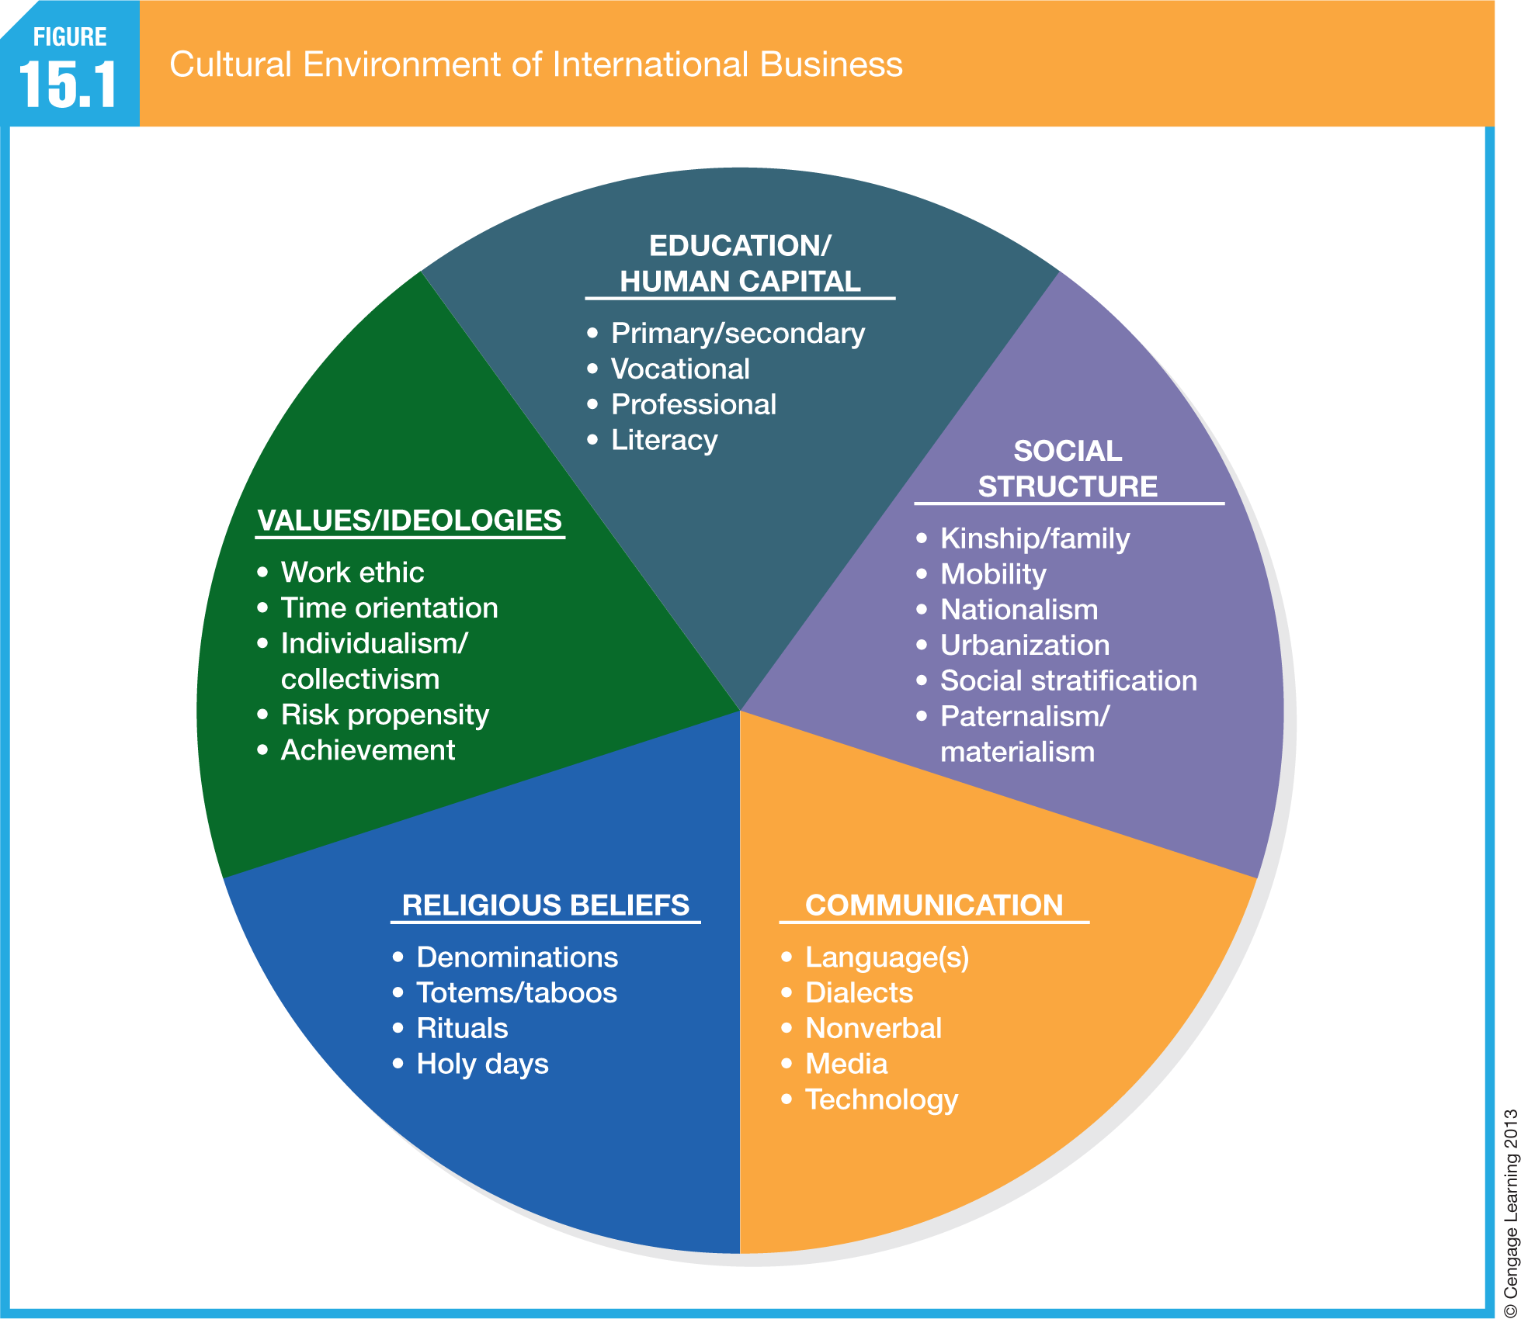

Slide 4
Managing Across Borders
International corporation
Domestic firm that uses its existing capabilities to move into overseas markets.
Multinational corporation (MNC)
Firm with independent business units operating in multiple countries.
Global corporation
Firm that has integrated worldwide operations through a centralized home office.
Transnational corporation
Firm that attempts to balance local responsiveness and global scale via a network of specialized operating units.

Slide 5
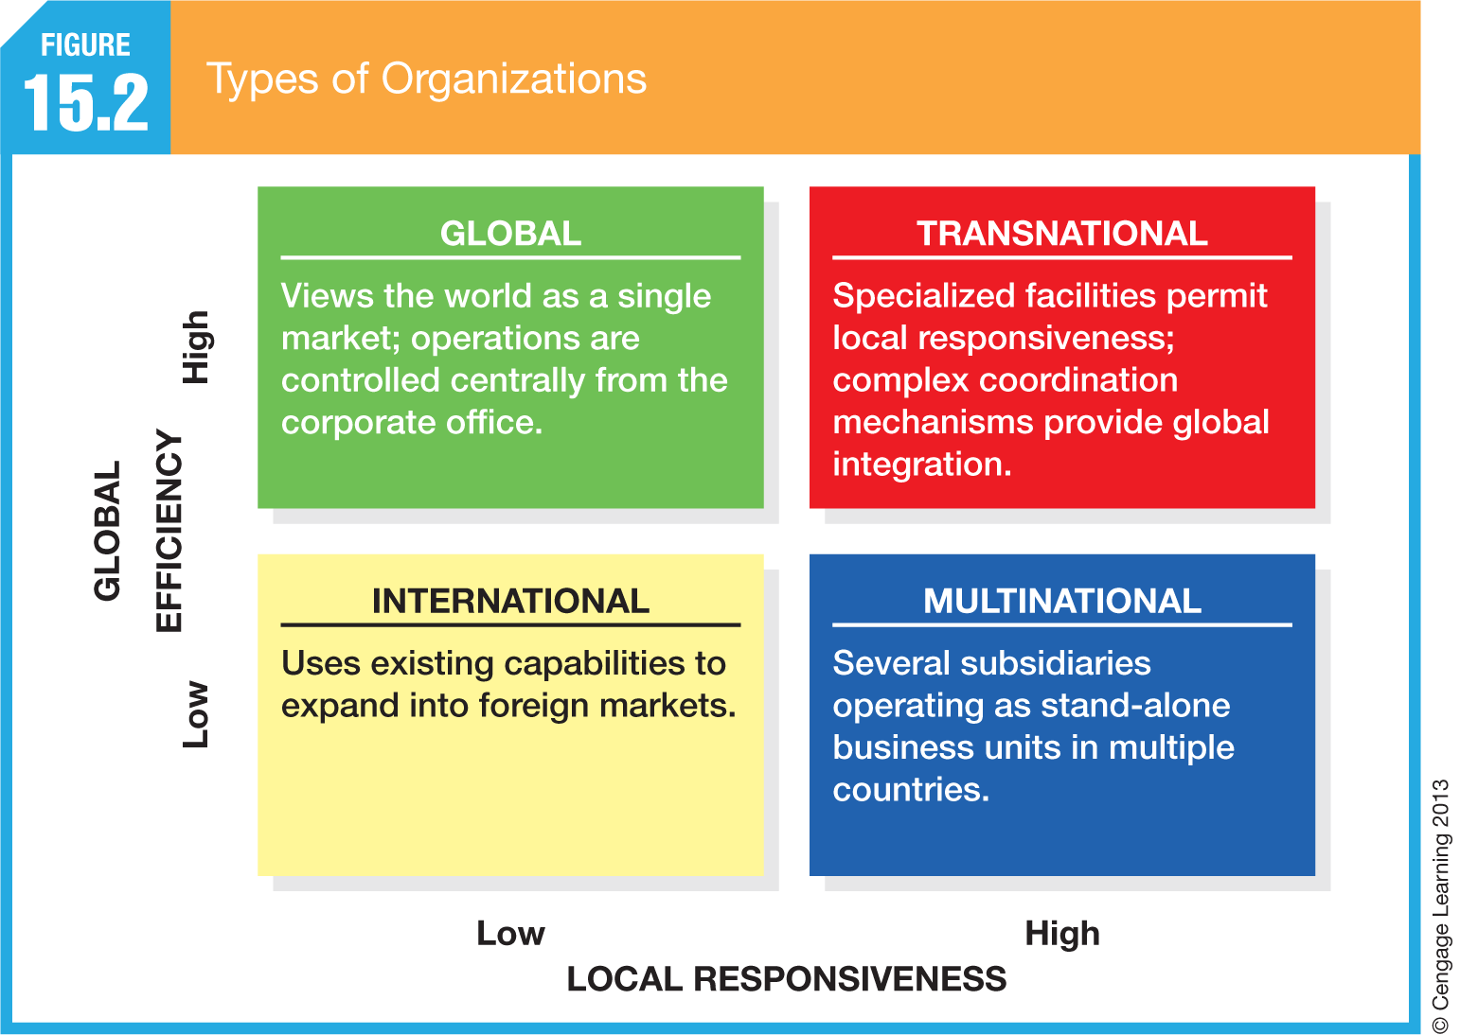
Types of Organizations

Slide 6
Domestic versus International HRM
Issues in international HRM in helping employees adapt to a new and different environment outside their own country:
Relocation
Orientation
Translation services

Slide 7
Staffing Internationally
Expatriates, or Home-country Nationals
Employees from the home country who are on international assignment.
Host-country Nationals
Employees who are natives of the host country.
Third-country Nationals
Employees who are natives of a country other than the home country or the host country.

Slide 8
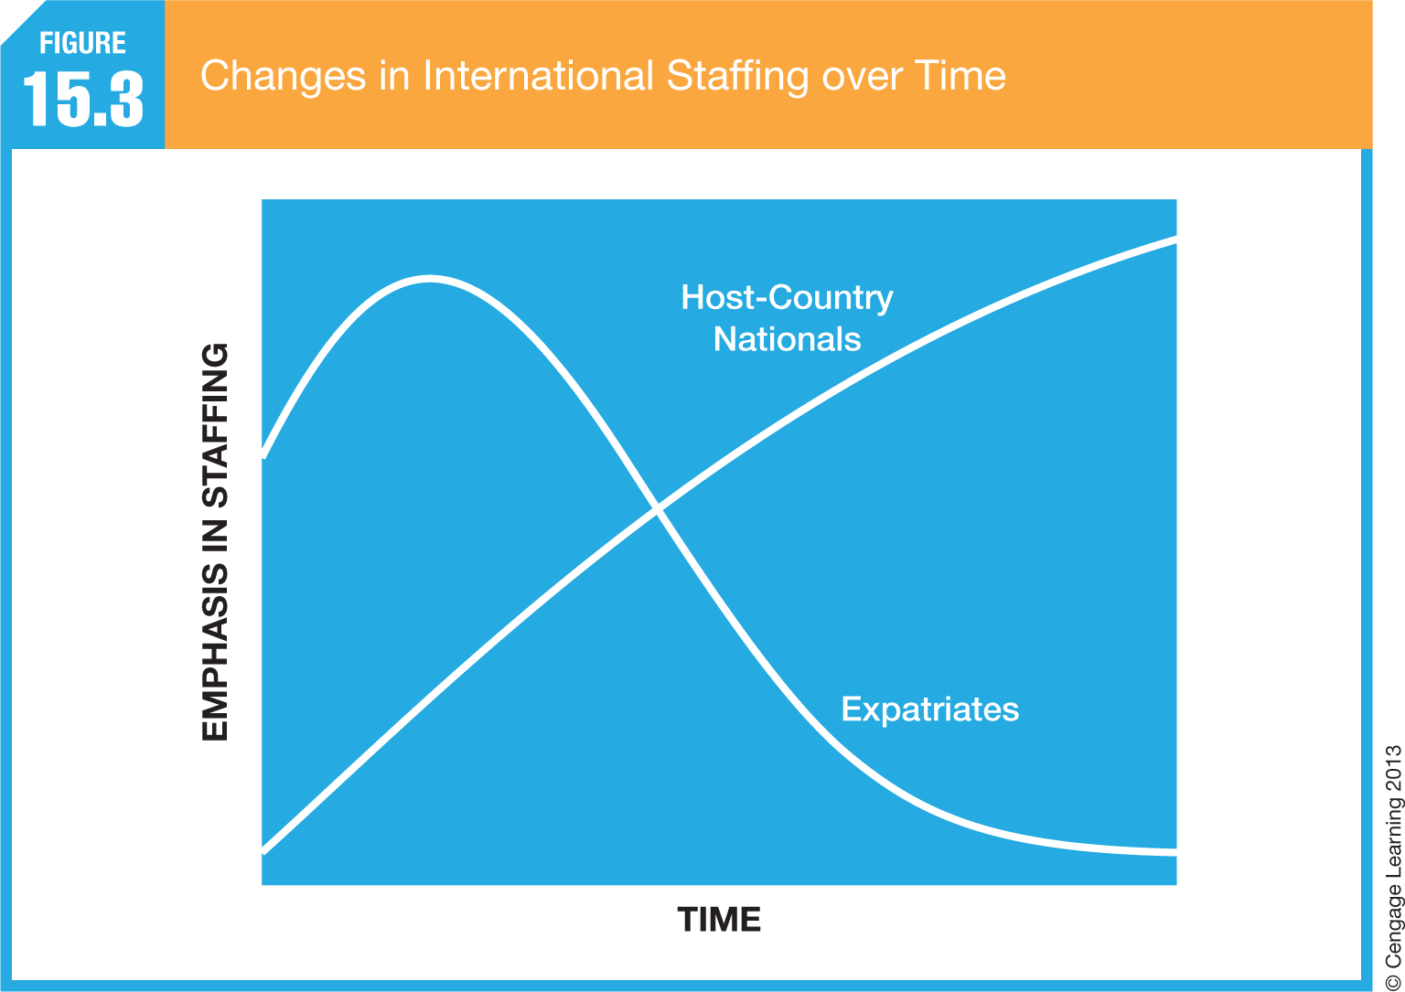
Changes in International Staffing over Time

Slide 9
Recruiting Internationally
Work Permit, or Visa
Government document granting a foreign individual the right to seek employment.
Guest Workers
Foreign workers invited to perform needed labor.
Apprenticeships
Vocational training programs in skilled trades.
Transnational Teams
Teams composed of members of multiple nationalities working on projects that span multiple countries.

Slide 10
Selecting Employees Internationally
Selecting employees in a foreign country environment can be difficult
Get to know the local market and customs in hiring
In India, much of the effective hiring was done through family ties and friendship networks
To better understand the local market there are a few things firms can do
International HR managers should get to know the universities, technical school’s, and primary schools in the area
International HR managers should develop network in the business and government communities
International HR managers must understand the employees of the firm’s competitors

Slide 11
Selecting Global Managers
Global Manager
A manager equipped to run an international business
Skills Categories for Global Managers
Ability to seize strategic opportunities
Ability to manage highly decentralized organizations
Awareness of global issues
Sensitivity to issues of diversity
Competence in interpersonal relations
Community-building skills

Slide 12
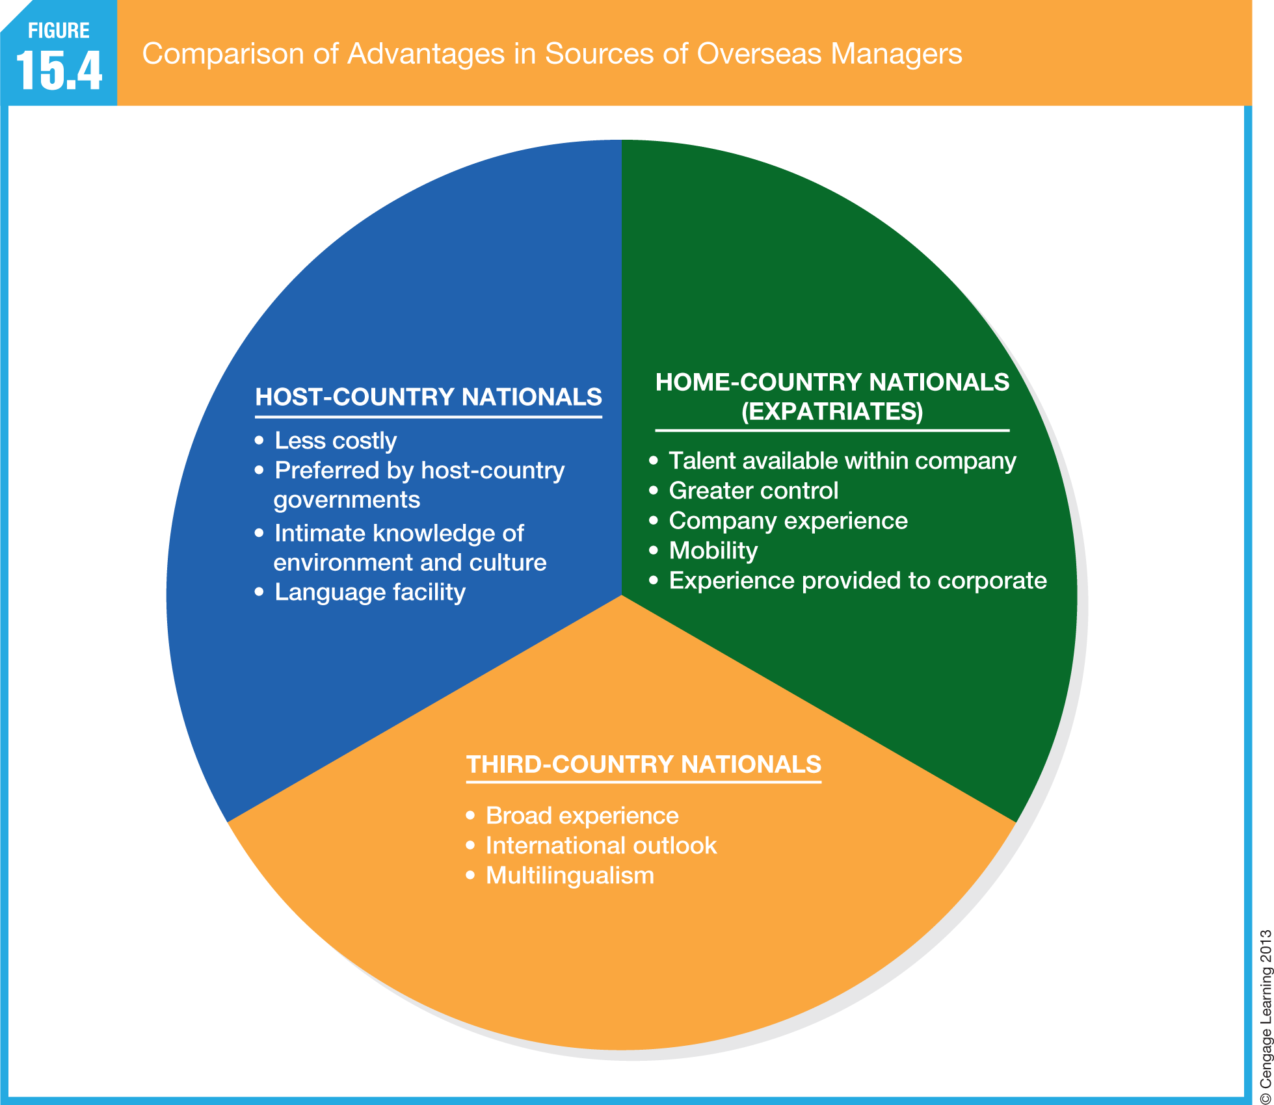

Slide 13
Selecting Global Managers (cont.)
Begin with self-selection.
Create a candidate pool.
Assess core skills.
Skills considered critical to an employee’s success abroad.
Assess augmented skills and attributes.
Skills helpful in facilitating the efforts of expatriate managers

Slide 14
Skills of Expatriate Managers

Slide 15
Expatriate Selection Criteria

Slide 16
Causes of Expatriate Assignment Failure

Slide 17
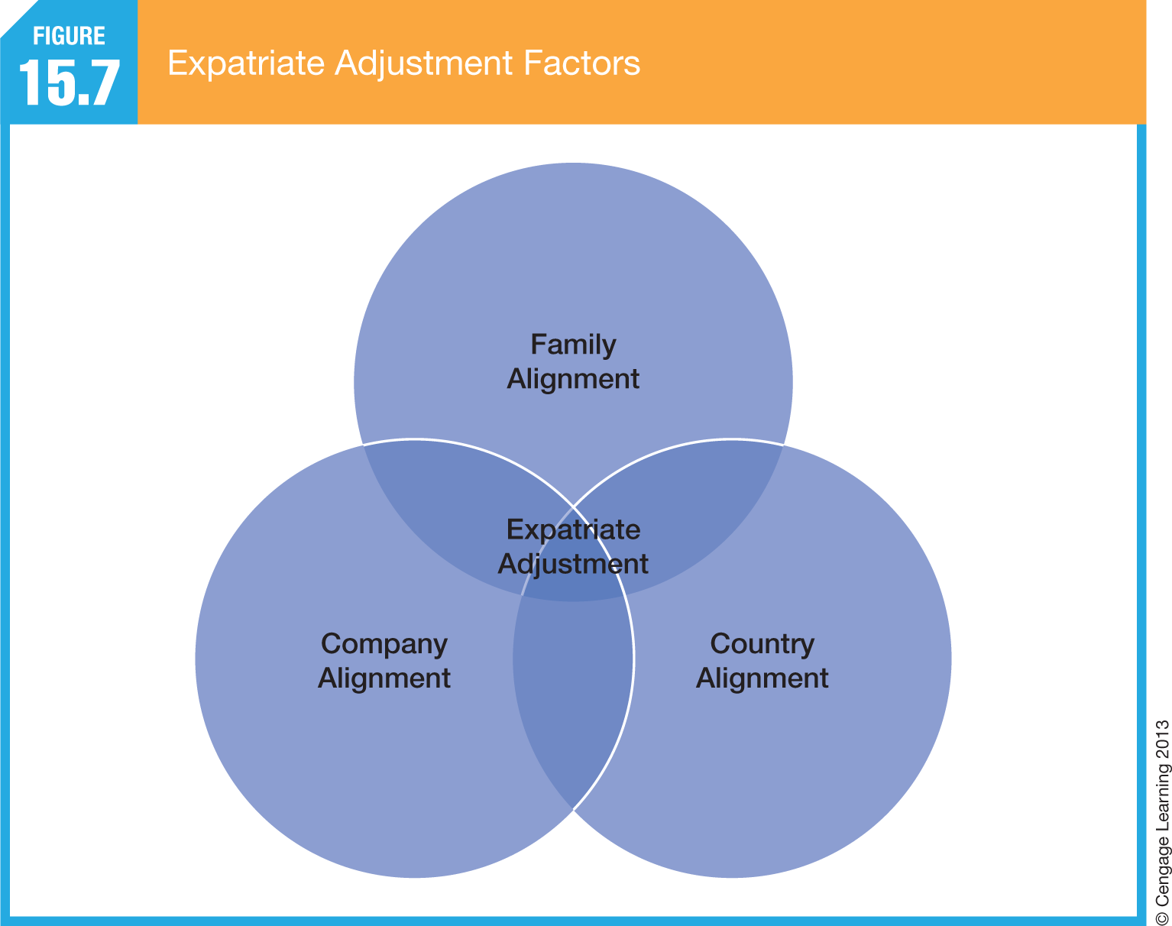
Expatriate Adjustment Factors

Slide 18
Training and Development
Essential training program content to prepare employees for working internationally:
Language training
Cultural training
Assessing and tracking career development
Managing personal and family life
Repatriation
Culture shock
Perpetual stress experienced by people who settle overseas.

Slide 19
Content of Training Programs
Those working internationally need to know as much as possible about:
The country where they are going, that country’s culture
That country’s culture, and
The history, values, and dynamics of their own organizations

Slide 20
Preparing for an International Assignment

Slide 22
Cultural Training
Reviewing available information about the host company: books, magazines, video tapes.
Conversations with host country natives.
Sensitivity training to become familiar with the customs and overcome prejudices.
Temporary assignments to encourage shared learning.

Slide 23
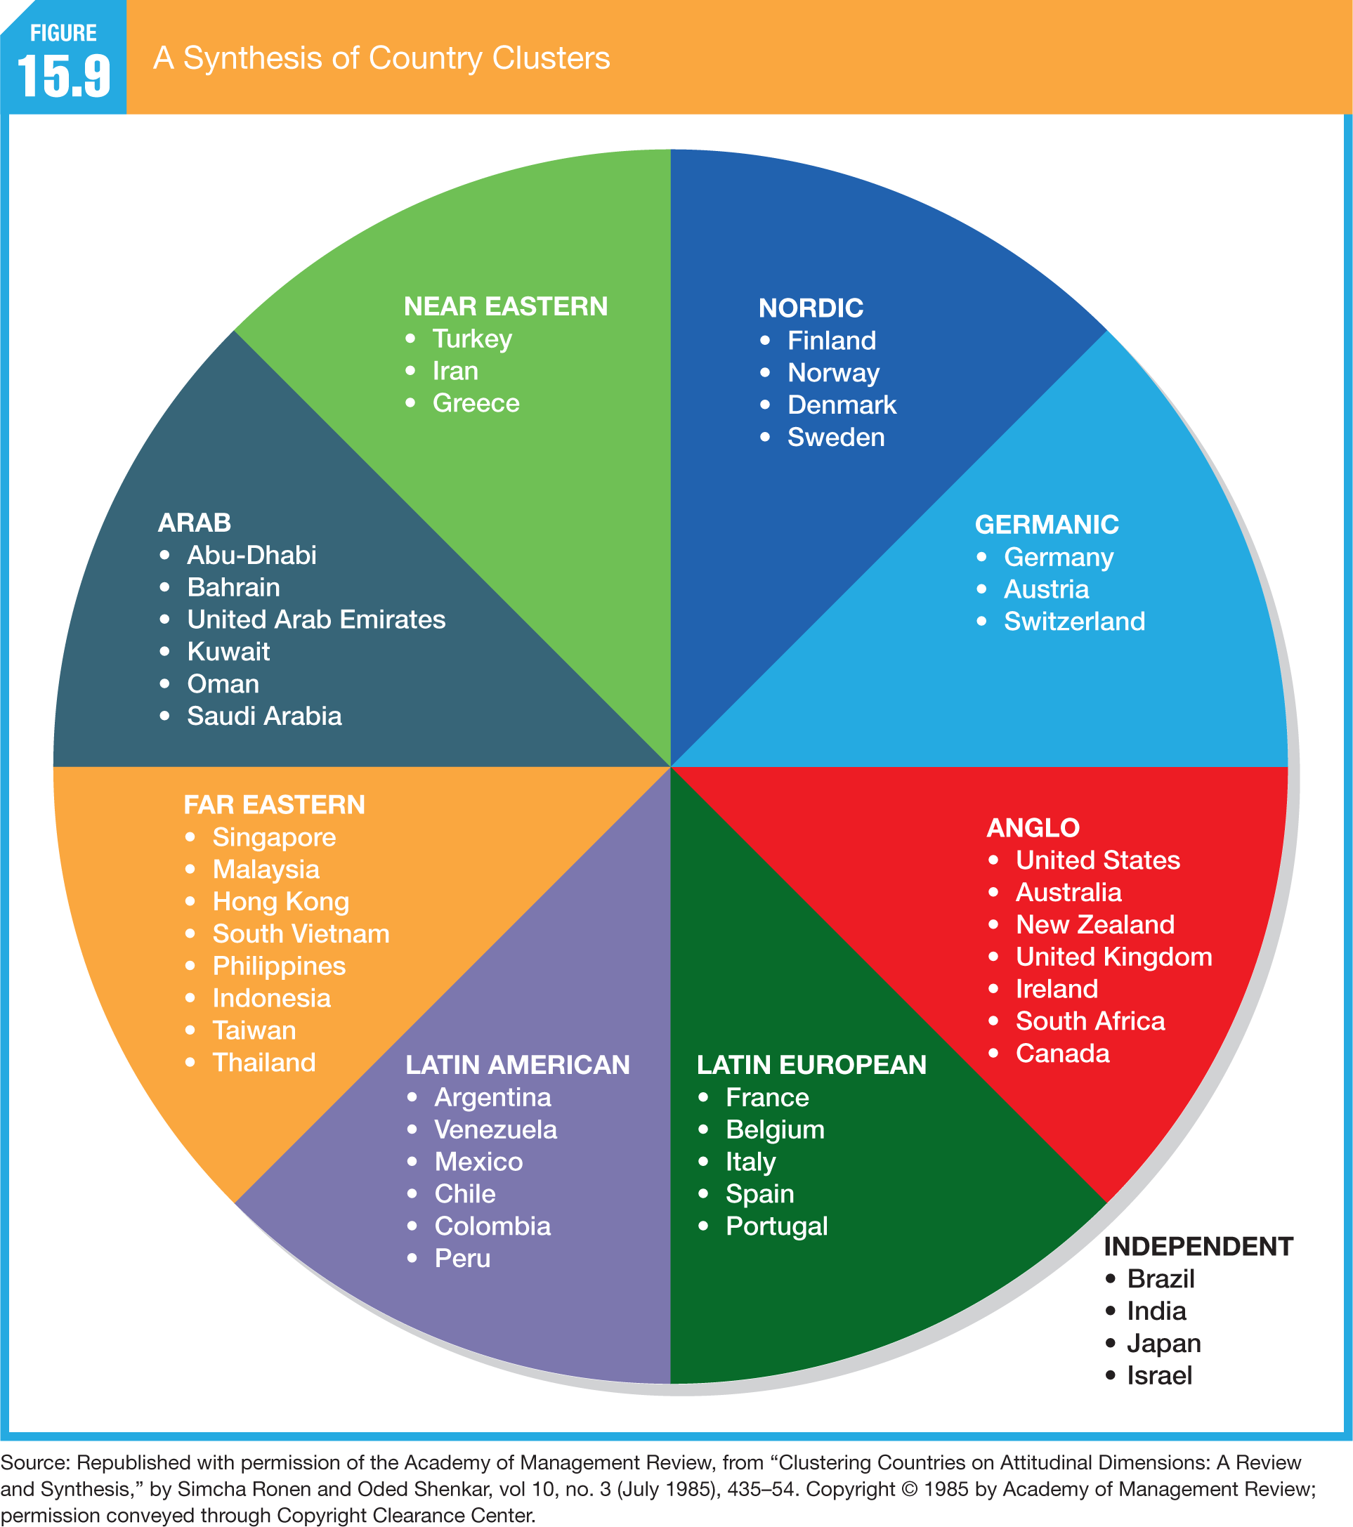

Slide 24
Assessing and Tracking Career Development
Developmental and Career Advantages of an International Assignment:
Increases the expatriate’s responsibilities and influence within the corporation
Provides a set of unique experiences beneficial to both the individual and the firm
Enhances understanding of the global marketplace
Offers the opportunity to work on a project important to the organization

Slide 25
Selected Foreign-Born Executives

Slide 27
Compensation
Different countries have different norms for employee compensation:
Financial (money) incentives versus nonfinancial incentives (prestige, independence, and influence)
Individual rewards versus collectivist concerns for internal equity and personal needs
General rule:
Match the rewards to the values of the local culture—create a pay plan that supports the overall strategic intent of the organization but provides enough flexibility to customize particular policies and programs to meet the needs of employees in specific locations.

Slide 28
Compensation of Host-Country Employees
Hourly wages can vary dramatically from country to country.
Pay periods are different.
Seniority may be an important factor.
High pay rates can upset local compensation practices.
Bonuses, profit-sharing, benefits and paid leave may be more extensive and legally required.

Slide 29
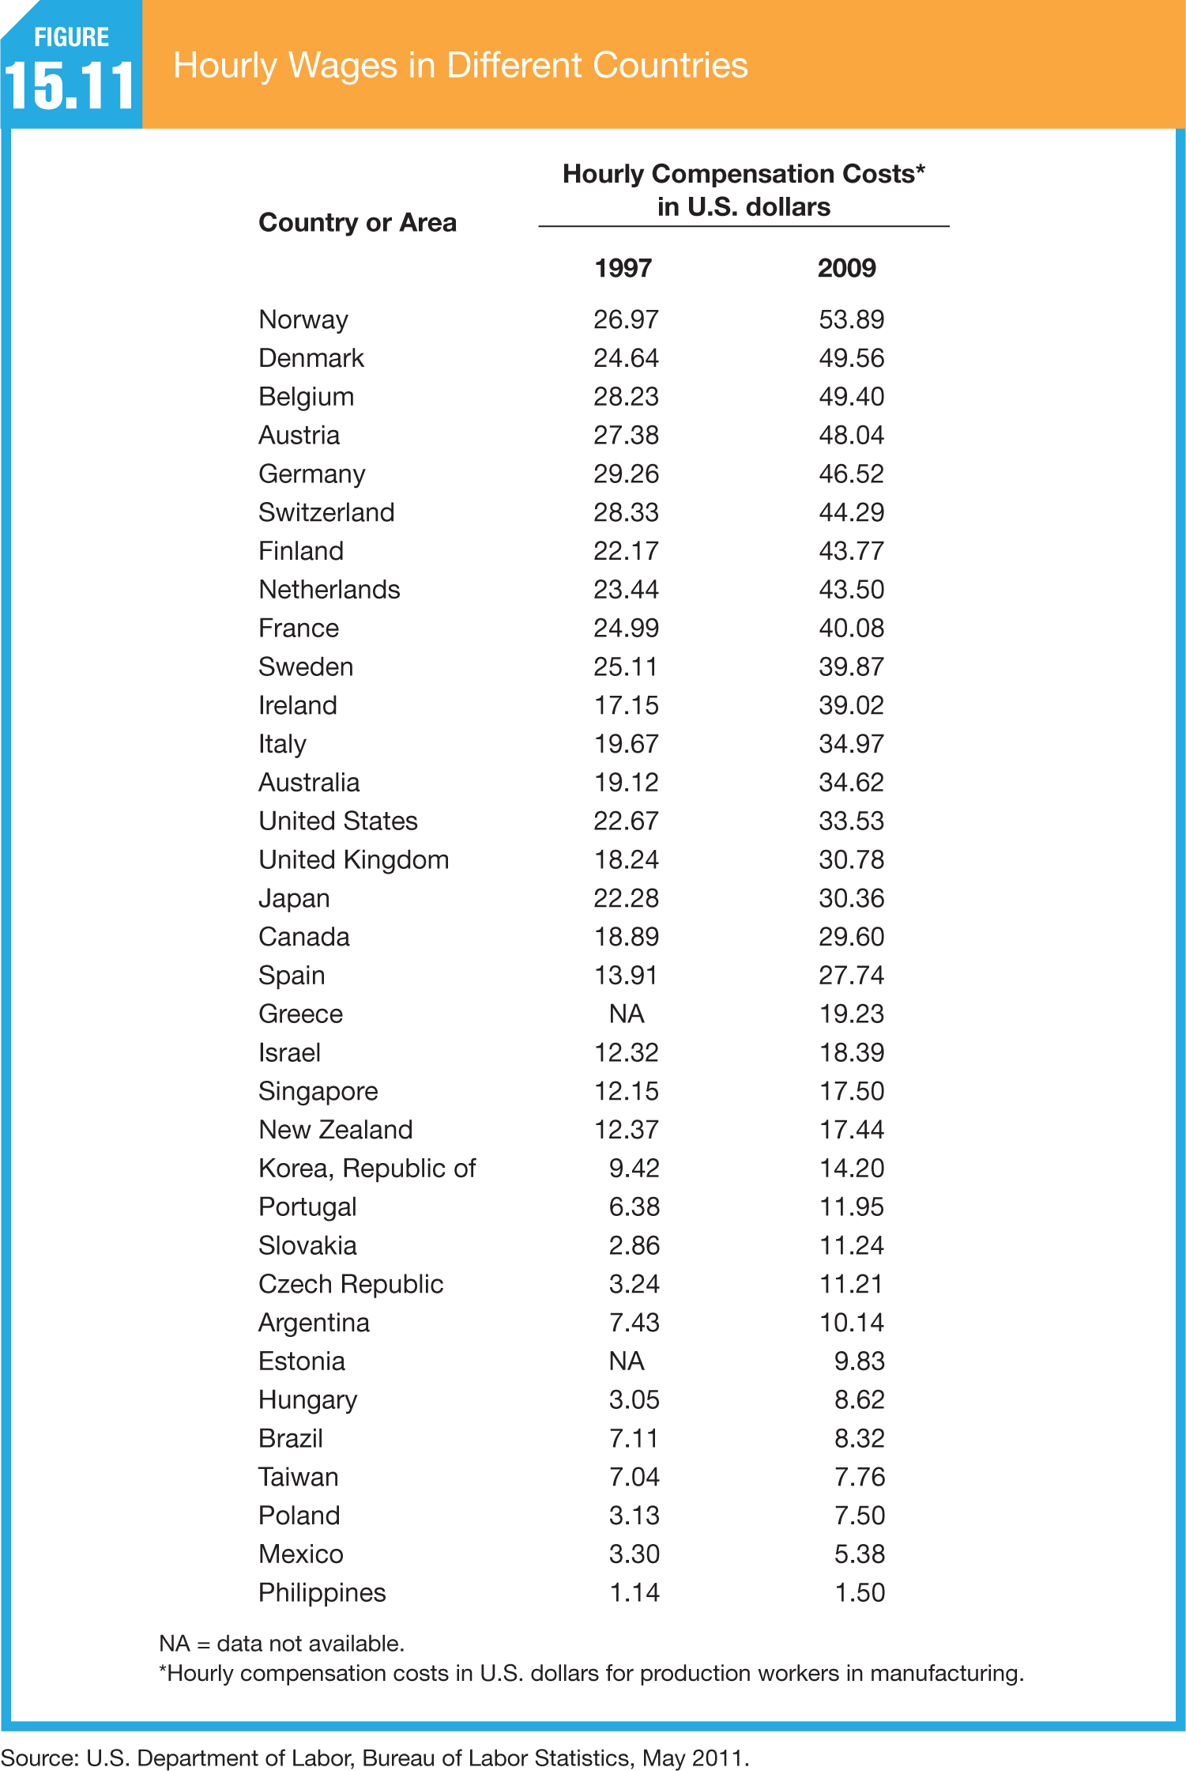

Slide 30
Compensation of Host-Country Managers
Global Compensation System
A centralized pay system whereby host-country employees are offered a full range of training programs, benefits, and pay comparable with a firm’s domestic employees but adjusted for local differences

Slide 31
Compensation of Expatriate Managers
An effective international compensation program must:
Provide an incentive to leave the United States
Allow for maintaining an American standard of living
Provide for security in countries that are politically unstable or present personal dangers
Include provisions for good health care
Reimburse the foreign taxes the employee is likely to have to pay (in addition to having to pay domestic taxes) and help him or her with tax forms and filing
Provide for the education of the employee’s children abroad, if necessary
Allow for maintaining relationships with family, friends, and business associates via trips home and other communication technologies
Facilitate the expatriate’s reentry home
Be in writing

Slide 32
Compensation of Expatriate Managers (cont.)
Home-Based Pay
Pay based on an expatriate’s home country’s compensation practices
Balance-Sheet Approach
A compensation system designed to match the purchasing power in a person’s home country
Calculate base pay
Figure cost-of-living allowance (COLA)
Add incentive premiums
Add assistance programs

Slide 33
Compensation of Expatriate Managers (cont.)
Split Pay
A system whereby expatriates are given a portion of their pay in the local currency to cover their day-to-day expenses and a portion of their pay in their home currency to safeguard their earnings from changes in inflation or foreign exchange rates
Host-Based Pay
Expatriate pay is comparable to that earned by employees in a host country to which the expatriate is assigned.

Slide 34
Compensation of Expatriate Managers (cont.)
Localization
Adapting pay and other compensation benefits to match that of a particular country
Reduces resentment among local staff members if they are earning significantly less.
Other Issues
Adequacy of medical care
Personal security
Compensation policies of competitors

Slide 35
Performance Appraisal
Who Should Appraise Performance?
Home-country evaluations
Host-country evaluations
Home versus Host-Country Evaluations
Local managers with daily contact with the person are more likely to have an accurate picture of his or her performance.
Performance Criteria – five steps:
Defining the assignment’s objectives.
Agreeing on the quantifiable measurements for the assignment.
Developing an equation that converts qualitative behavior into quantifiable measurements.
Evaluating the expatriate’s performance against these measurements.
Calculating the ROI. This can be a complex cost accounting or a simple calculation to see if the expatriate covered the cost of keeping them on assignment.
Providing Feedback

Slide 36
The Labor Environment Worldwide
International Differences in Unions:
The level at which bargaining takes place (national, industry, or workplace)
The degree of centralization of union-management relations
The scope of bargaining (parties and issues)
The degree to which government intervenes
The degree of unionization and union strength
The political affiliations of unions

Slide 37
Collective Bargaining in Other Countries
Collective Bargaining in Other Countries
When we look at other countries, wefind that the process can vary widely, especially with regard to the role of government.
International Labor Organizations
The most active of the international union organizations has been the International Trade Union Confederation (ITUC), which has its headquarters in Brussels.
Another active and influential organization is the International Labour Organization (ILO), a specialized agency of the United Nations created in 1919.

Slide 38
Labor Participation in Management
Labor Participation in Management
In many European countries, provisions for employee representation are established by law.
A higher form of worker participation in management is found in Germany, where representation of labor on the board of directors of a company is required by law.
This arrangement is known as codetermination
Each of these differences makes managing human resources in an international context more challenging.

Slide 39
Key Terms
augmented skills
balance sheet approach
codetermination
core skills
cultural environment
culture shock
expatriates, or home-country
nationals
failure rate
global compensation system
global corporation
global manager
guest workers
home-based pay
host-based pay
host country
host-country nationals
international corporation
localization
multinational corporation (MNC)
repatriation
split pay
third-country nationals
transnational corporation
transnational teams
work permit, or visa

