Slide 1
Employee Rights and Discipline
The Challenges of Human Resources Management

Slide 2
Rights Affecting the Employment Relationship
Employment-at-Will (EAW)
Wrongful and Constructive Discharge
The Employment Relationship
Just Cause
Due Process
Distributive and Procedural Justice

Slide 3
What is Employment-at-Will?
Employment-at-will is not a law. It is a doctrine based on common law.
Employment-at-will is a legal doctrine that states that an employment relationship may be terminated by the employer or employee at any time and for any or no reason.
This means that an employer does not need good cause to involuntarily terminate an employee. In every state but Montana (which protects employees who have completed an initial probationary period from being fired without cause), employers are free to adopt at-will employment policies.
Approximately 2 of every 3 U.S. workers depend almost entirely on continued good will of employer.
Notes:
No U.S. state but Montana has chosen to statutorily modify the employment at-will rule. In 1987, the Montana legislature passed the Wrongful Discharge from Employment Act (WDEA). The WDEA Act is unique in that, although it purports to preserve the at-will concept in employment law, it also expressly enumerates the legal bases for a wrongful discharge action. Under the WDEA, a discharge is wrongful only if: "it was in retaliation for the employee's refusal to violate public policy or for reporting a violation of public policy; the discharge was not for good cause and the employee had completed the employer's probationary period of employment; or the employer violated the express provisions of its own written personnel policy.

Slide 4
Not Included
Individuals with a contract for a specified time period
Those with collective bargaining agreements
Those with annual contracts (i.e., teachers)
Whistleblowers

Slide 5
How Employers Can Protect Themselves
No statements suggesting job security or permanent employment
No statements during job interviews that suggest a promise, such as, "You can expect to hold this job as long as you want"
No hiring without a signed acknowledgment of at-will disclaimer
Notes:
Employers can do certain things to help protect against wrongful discharge litigation based on a breach of implied employment contract.
First, handbooks and policy manuals should clearly state that employment is an at-will relationship, and no statements during the job interview should suggest job security or permanent employment.
Second, interviewers should be trained not to make any promises about employment to candidates, because these statements can be considered a contractual agreement and grounds for a lawsuit.
Finally, a person should not be hired without a signed acknowledgment of an at-will disclaimer.

Slide 6
How Employers Can Protect Themselves (cont’d)
Clearly defining worker’s duties
Providing good feedback on regular basis
Conducting realistic performance appraisals on regular basis
No law involving ethical considerations for employment-at-will
Notes:
Other guidelines that may assist organizations in avoiding wrongful termination suits include clearly defining the worker’s duties, providing feedback on a regular basis, and conducting realistic performance appraisals. While an employer has a legal right to terminate an employee at will, there are ethical boundaries to be considered that include:
Terminate only as a last resort, after all other options have been exhausted
Give as much notice as possible
Provide as much severance pay and other help as possible
Never terminate an employee for anything other than a legitimate business reason
Never lie to an employee about the reason for termination
Treat the employee with as much dignity and respect as possible

Slide 7
Exceptions to Employment-at-Will
There are three major exceptions to the employment-at-will doctrine, as developed in common law. These exceptions are based on each state’s case laws.* The exceptions are:
Public policy
Implied contract
Covenant of good faith
* An article on employment-at-will and chart of state exceptions is found at http://www.bls.gov/opub/mlr/2001/01/art1full.pdf

Slide 8
Exceptions to Employment-at-Will (cont’d)
Public Policy:
This is the most widely-accepted exception (43 states).
Under the public-policy exception to employment-at-will, an employee is wrongfully discharged when the termination is against an explicit, well-established public policy of the state. The majority view among states is that public policy may be found in either a state constitution, statute, or administrative rule, but some states have either restricted or expanded the doctrine beyond this bound.
Example - Palmateer v. International Harvester Company – employee claimed he was terminated for providing information to law enforcement about employer criminal acts; the court found that public policy favored the exposure of criminal activity.

Slide 9
Notes:
43 States have a Public Policy exception to the employment-at-will doctrine.
Data are from David J. Walsh and Joshua L. Schwarz,
"State Common Law Wrongful Discharge Doctrines: Up-date, Refinement,
and Rationales," 33 Am. Bus. L.J. 645 (summer 1996). Case law
was shepardized (verified) to update the recognition of exceptions through
Oct. 1, 2000.

Slide 10
Exceptions to Employment-at-Will (cont’d)
Implied Contract:
The second major exception to the employment-at-will doctrine is applied when an implied contract is formed between an employer and employee, even though no express, written instrument regarding the employment relationship exists. Although employment is typically not governed by a contract, an employer may make oral or written representations to employees regarding job security or procedures that will be followed when adverse employment actions are taken. If so, these representations may create a contract for employment. This exception is recognized in 38 of the 50 states.
Examples: policy language, employment offers, supervisor statements.
Example - Toussaint v. Blue Cross & Blue Shield of Michigan – the employer had a policy of just cause terminations and did not follow established procedures.

Slide 11
Notes:
38 states have an Implied Contract exception.
Data are from David J. Walsh and Joshua L. Schwarz,
"State Common Law Wrongful Discharge Doctrines: Up-date, Refinement,
and Rationales," 33 Am. Bus. L.J. 645 (summer 1996). Case law
was shepardized (verified) to update the recognition of exceptions through
Oct. 1, 2000.

Slide 12
Exceptions to Employment-at-Will (cont’d)
Covenant of Good Faith and Fair Dealing:
The exception for a covenant of good faith and fair dealing represents the most significant departure from the traditional employment-at-will doctrine. Rather than narrowly prohibiting terminations based on public policy or an implied contract, this exception—at its broadest—reads a covenant of good faith and fair dealing into every employment relationship. It has been interpreted to mean either that employer personnel decisions are subject to a "just cause" standard or that terminations made in bad faith or motivated by malice are prohibited. This exception is recognized by only 11 states.
Example - Cleary v. American Airlines – An employee with 18 years of service was terminated without any reason. The court stated that "Termination of employment without legal cause after such a period of time offends the implied-in-law covenant of good faith and fair dealing" and that, from the covenant, "a duty arose on the part of...American Airlines…to do nothing which would deprive...the employee...of the benefits of the employment...having accrued during [the employee’s] 18 years of employment."

Slide 13
Notes:
11 states have a Covenant of Good Faith and Fair Dealing exception
Data are from David J. Walsh and Joshua L. Schwarz,
"State Common Law Wrongful Discharge Doctrines: Up-date, Refinement,
and Rationales," 33 Am. Bus. L.J. 645 (summer 1996). Case law
was shepardized (verified) to update the recognition of exceptions through
Oct. 1, 2000.

Slide 14
Steps to Reduce Employer Liability
Steps to take to minimize employer liability for adverse employment actions:
Use disclaimers in the new hire process (offer letters and new hire orientation) and require signed acknowledgements.
Outline clearly employment expectations.
Implement a progressive discipline policy.
Adopt a grievance procedure
Train supervisors.
Remind managers to document disciplinary actions.
Include human resources in the disciplinary process.
Review situations carefully and seek legal guidance prior to making adverse employment decisions.

Slide 15
Employer Checklist for Adverse Employment Actions
Employer checklist when considering adverse employment actions*
Is the proposed action fair?
Is the proposed action consistent with employer policies and practices?
Is the proposed action made based on business needs (not made due to other factors, i.e. discriminatory reasons)?
Is there good documentation to support items1-3 above?
*HR Magazine, Keep ‘Em at Will; Treat ‘Em for Cause, May 2005

Slide 16
Employment-at-Will Restrictions
Wrongful Discharge
Termination of an individual’s employment for improper or illegal reasons .
Fortune v. National Cash Register
Constructive Discharge
An employer deliberately makes working conditions intolerable in an attempt to get (to force) an employee to resign or quit.
Discharge as a Result of Retaliation
whether an "adverse action" (following from a complaint or "protected activity") would tend to discourage other people from complaining.
Notes:
Fortune v. National Cash Register
Facts:
P was employed as a salesman for D for 25 years on an at-will contract.
P was paid salary and commission based on what he sold and who he sold it to.
D introduced a new cash register and wanted to sell it to P's customer First National. P helped with the transaction and was awarded commission on the eventual sale.
The day after the order from First National was placed, a termination notice was written to P. He did not receive the notice until a month later.
P's boss told him that P was indeed fired but asked P to stay on to help smooth out the operation of the sale with First National.
P received 75% commission while he stayed on. When P inquired about receiving 100%, he was told to forget about it.
P was asked to retire; P refused and was fired. P did not receive any bonus payments on machines delivered to First National after that date.

Slide 17
Tips to Avoid Wrongful Employment Termination Lawsuits

Slide 18
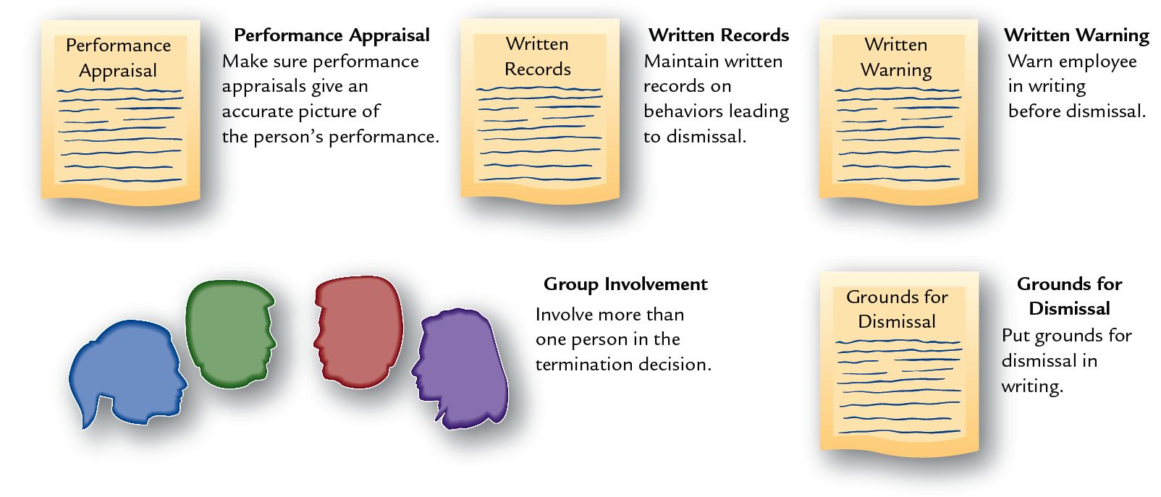
Preparing a Defense Against Wrongful Discharge: The "Paper Trail"

Slide 19
Employment-at-Will Restrictions
Wrongful Discharge
Termination of an individual’s employment for improper or illegal reasons .
Fortune v. National Cash Register
Constructive Discharge
An employer deliberately makes working conditions intolerable in an attempt to get (to force) an employee to resign or quit.
Discharge as a Result of Retaliation
whether an "adverse action" (following from a complaint or "protected activity") would tend to discourage other people from complaining.
Notes:
Thinking of bullying as perhaps an example of an employee filing suit citing constructive discharge.

Slide 20
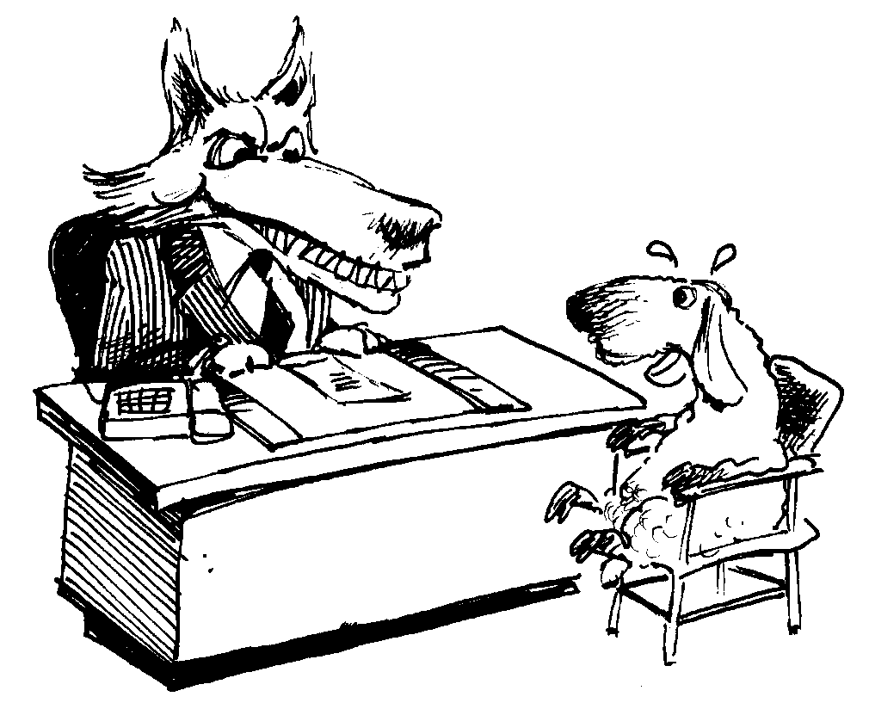
Constructive Discharge
Extraordinary change
Intolerable working conditions

Slide 21
Illegal Employee Dismissals
Constructive Discharge
An employee voluntarily terminates his or her employment because of harsh, unreasonable employment conditions placed on the individual by the employer.
Employers cannot accomplish covertly what they are prohibited by law from achieving overtly.
Courts have generally adopted a "reasonable person" standard for upholding constructive discharge claims.

Slide 22
Bullying …
Legal Remedies for Workplace Bullying: Grabbing the Bully by the Horns
Notes:
Thinking of bullying as perhaps an example of an employee filing suit citing constructive discharge.

Slide 23
Employment-at-Will Restrictions
Wrongful Discharge
Termination of an individual’s employment for improper or illegal reasons .
Fortune v. National Cash Register
Constructive Discharge
An employer deliberately makes working conditions intolerable in an attempt to get (to force) an employee to resign or quit.
Discharge as a Result of Retaliation
whether an "adverse action" (following from a complaint or "protected activity") would tend to discourage other people from complaining.
Notes:
Thinking of bullying as perhaps an example of an employee filing suit citing constructive discharge.

Slide 24
Illegal Employee Dismissals (cont.)
Discharge as a Result of Retaliation
Title VII of the Civil Rights Act, the Age Discrimination in Employment Act, the Americans with Disabilities Act, and other employment laws prohibit employers from retaliating against employees when exercising their rights under these statutes.
Proper handling of these employees involves:
Taking no adverse employment action against employees when they file discrimination charges.
Treating the employees consistently and objectively.
Harboring no animosity toward the employees when they file discrimination lawsuits.

Slide 25
The 12 Most Common Workplace Retaliation Tactics
Left out
Cold shoulder
Managerial abuse
Potential job loss
No promotion
Abuse by coworkers
Pay cut
Relocation or reassignment
Downgraded
Online abuse
Physical harm
Home harassment

Slide 26
Employment-at-Will: Fairness
Just Cause
Reasonable justification for taking an employment-related action.
Due Process
The means used to allow individuals to explain and defend their actions against charges or discipline.
Distributive Justice
Perceived fairness in the distribution of outcomes.
Procedural Justice
Perceived fairness of the process used to make decision about employees.

Slide 27
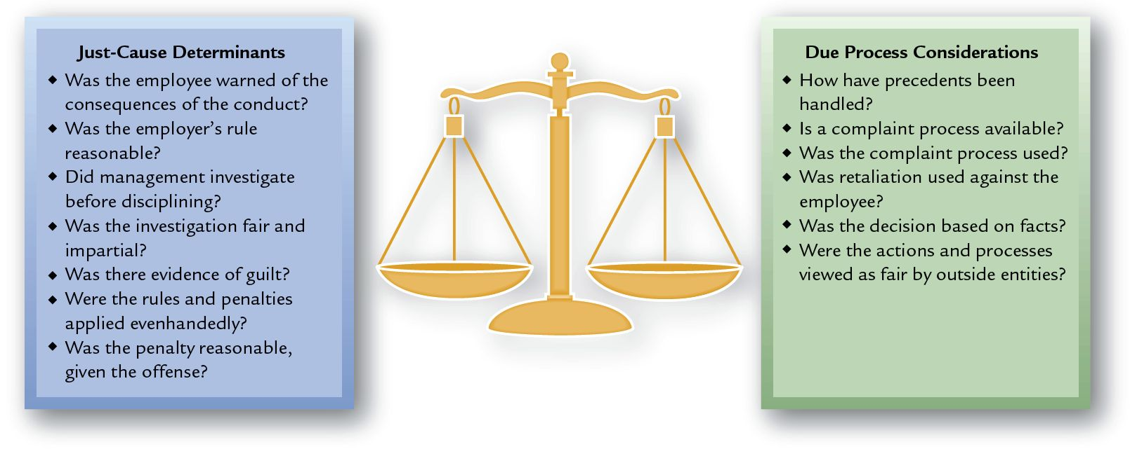
Criteria for Evaluating Just Cause and Due Process

Slide 28
Explicit Contracts Most Widely Used Restrictions
Explicit Contracts Restrictions
Nondisclosure of
Information Agreement
Noncompete
Agreement
Intellectual Property Agreements
Nonpiracy
Agreements
Notes:
Many of these are preemployment agreements. Preemployment agreements require that job applicants sign contracts promising to engage in or refrain from certain behaviors in order to be considered for employment (Soper el al. 2004). There is generally little or no negotiation. Employers write contracts and applicants sign them. Employers typically reject changes proposed by applicants unless the applicants or their skills are in great demand. In fact, if applicants request too many changes, employers may not hire such potential "troublemakers."
Two more recent popular preemployment agreements is to have the employee (especially new hires) are: 1) Training Expense Reimbursement and 2) Mandatory Dispute Resolution which attempts to combat costly litigation by having employees submit disagreements with the company to arbitration and agree to forego the filing of any lawsuits.
Alternative dispute resolution—arbitration.

Slide 29
Alternative Dispute Resolution
"ADR"
Different types of employee complaint or dispute-resolution procedures used to meet employees’ expectations for fair treatment in the workplace while guaranteeing them due process.
ADR Procedures
Step-Review Systems
Peer-Review Systems
Open-Door Policy
Ombudsman System
Mediation
Arbitration

Slide 30
Alternative Dispute Resolution Procedures
Step-Review System
System for reviewing employee complaints and disputes by successively higher levels of management.
Peer-Review System
A group composed of equal numbers of employee representatives and management appointees.
Functions as a jury since its members weigh evidence, consider arguments, and after deliberation, vote independently to render a final decision.

Slide 31
Additional ADR Procedures
Open-Door Policy
A policy of settling grievances that identifies various levels of management above the immediate supervisor for employee contact.
Ombudsman System
Ombudsman
Is a designated individual from whom employees may seek counsel for the resolution of their complaints.
Is an advocate for a fair process, not an advocate on behalf of individuals or the institution.
Does not have the power to decide or to overrule a decision, but can confidentially seek an equitable solution between the employee and the supervisor.

Slide 32
Third-party Dispute Resolution
Mediation
The use of an impartial neutral to reach a compromise decision in employment disputes
Mediator
A third party in an employment dispute who meets with one party and then the other in order to suggest compromise solutions or to recommend concessions from each side that will lead to an agreement.

Slide 33
Third-party Dispute Resolution (cont.)
Arbitration
The use of an impartial neutral party as decision maker to resolve an employment labor dispute by imposing a binding final decision on all parties involved in the dispute.
Arbitrator
Third-party neutral who resolves a labor dispute by issuing a final decision in the disagreement.

Slide 34
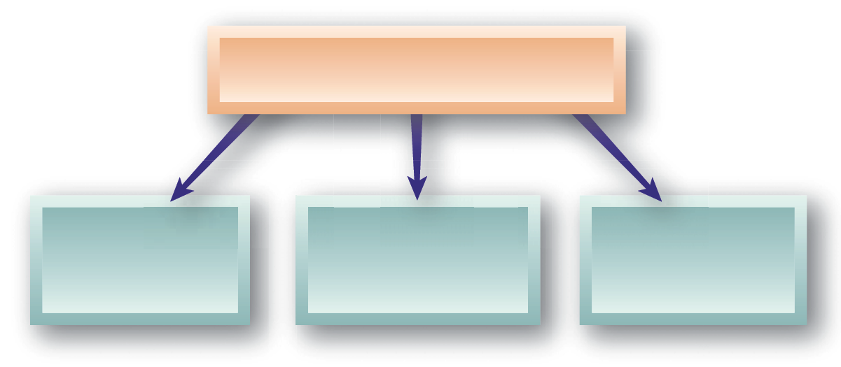
Employees’ Free Speech Rights
Employers’ Restrictions on Employees’ Free Speech Rights
Advocacy of Controversial Views
Engaging in Whistle-Blowing
Publication of Blogs
Notes:
Employee blogs can create workplace problems.
After The Reynolds and Reynolds Co., which creates computer systems for car retailers, was acquired by another company in 2006, it lost customers, laid off employees and suffered low employee morale.
An anonymous blogger named "Trooper" in 2007 started a blog, hosted by Google, that criticized Reynolds, comparing the new CEO to Bernie Madoff and Satan, and calling him an idiot, a lunatic and a crook. Reynolds’ new CEO didn’t take kindly to that and went to court to get Google to cough up the identity of Trooper, whom management suspected of being an employee.
In 2011, the trial court agreed to force Google to reveal Trooper’s name, address, phone number, and email address, and an appeals court affirmed. While the original blog seems to have disappeared, another has taken its place. Trooper continues to resist Reynolds’s attempt to find him and has now convinced the Texas high court to rule on the matter.
He claims that forcing Google to disclose his identity would violate his free speech rights, and he also says the company hasn’t shown that it’s been defamed or that he’s violated any duty to it.

Slide 35
Advocacy of Controversial Views
Chick-Fil-A President Don Cathy when he told religious publications that he and his family-owned restaurant is “guilty as charged” for financially supporting groups that advocate “the biblical definition of a family unit.”
Professor at Notre Dame (a Catholic University) was fired after advocating pro choice; professor at Baptist seminary was terminated for advocating evolution.
Generally not a good idea for leaders to take a stand on controversial issues that are unrelated to the business.
What say you?

Slide 36
The Contraceptive Mandate in the Affordable Care Act
Hobby Lobby claims that its Christian values should make it exempt from providing health care coverage that includes "emergency contraception," which "might end a life after the moment of conception.“
Should women’s healthcare choices be dictated by the religious beliefs of business owners?
Should women’s healthcare choices be impeded by an employer’s objections to a law that provides essential healthcare options to their female employees?
Are secular, for-profit corporations excepted from federal and state laws by the religious beliefs of business owners?
Notes:
Case to be heard, along with another case involving a Mennonite family company, to be heard by the US Supreme Court in March 2014.

Slide 37
Employee Blogs Can Create Workplace Problems
Your employer’s reputation may be badly damaged if you write negative comments about your employment or your employer’s goods or services.
In one high-profile incident, the author of a blog called "Diary of a Dysfunctional Flight Attendant" was fired after she posted risqué photos of herself in her airline uniform.
Another case involved an employee who lost his job after criticizing company management on a website; based on his "disloyal, disparaging, and injurious" comments about company management, the court upheld the employee’s termination.
A man who worked for a sheriff’s department was fired after he posted comments on the Internet comparing the sheriff and co-workers to Hitler and the Nazis. The court rejected his First Amendment claims because the comments were found to be defamatory and likely to cause disruption at work.

Slide 38
Whistleblowing
Whistleblowing
Complaints to governmental agencies by employees about their employers’ illegal or immoral acts or illegal practices
Laws Protecting Whistleblowers from Retaliation:
Sarbanes-Oxley (S-O) Act of 2002 protects publicly-traded company employees
Whistleblower Protection Act (WPA) protects federal employees.
Notification and Federal Employee Antidiscrimination and Retaliation Act (No Fear Act) of 2002
False Claims Act (FCA)

Slide 39
Privacy Rights and Employee Records
ADA Provisions
Employee medical records are kept as separate confidential files available under limited conditions specified in the ADA.
Security of Employee Records
Restrict access to all records
Set confidential passwords to HRIS databases
Keep sensitive information in separate files and restricted databases
Inform employees about data retained
Purge outdated data from records
Release information only with employee’s consent

Slide 40
Access to Personnel Files
Employees generally have:
The right to know of the existence of one’s personnel file
The right to inspect one’s own personnel file
The right to correct inaccurate data in the file
Employers can:
Restrict access to information that could violate the privacy of others
Limit the employee to copies of documents that he or she has signed
Require that HR personnel, or a supervisor, be present while the employee views the documents

Slide 41
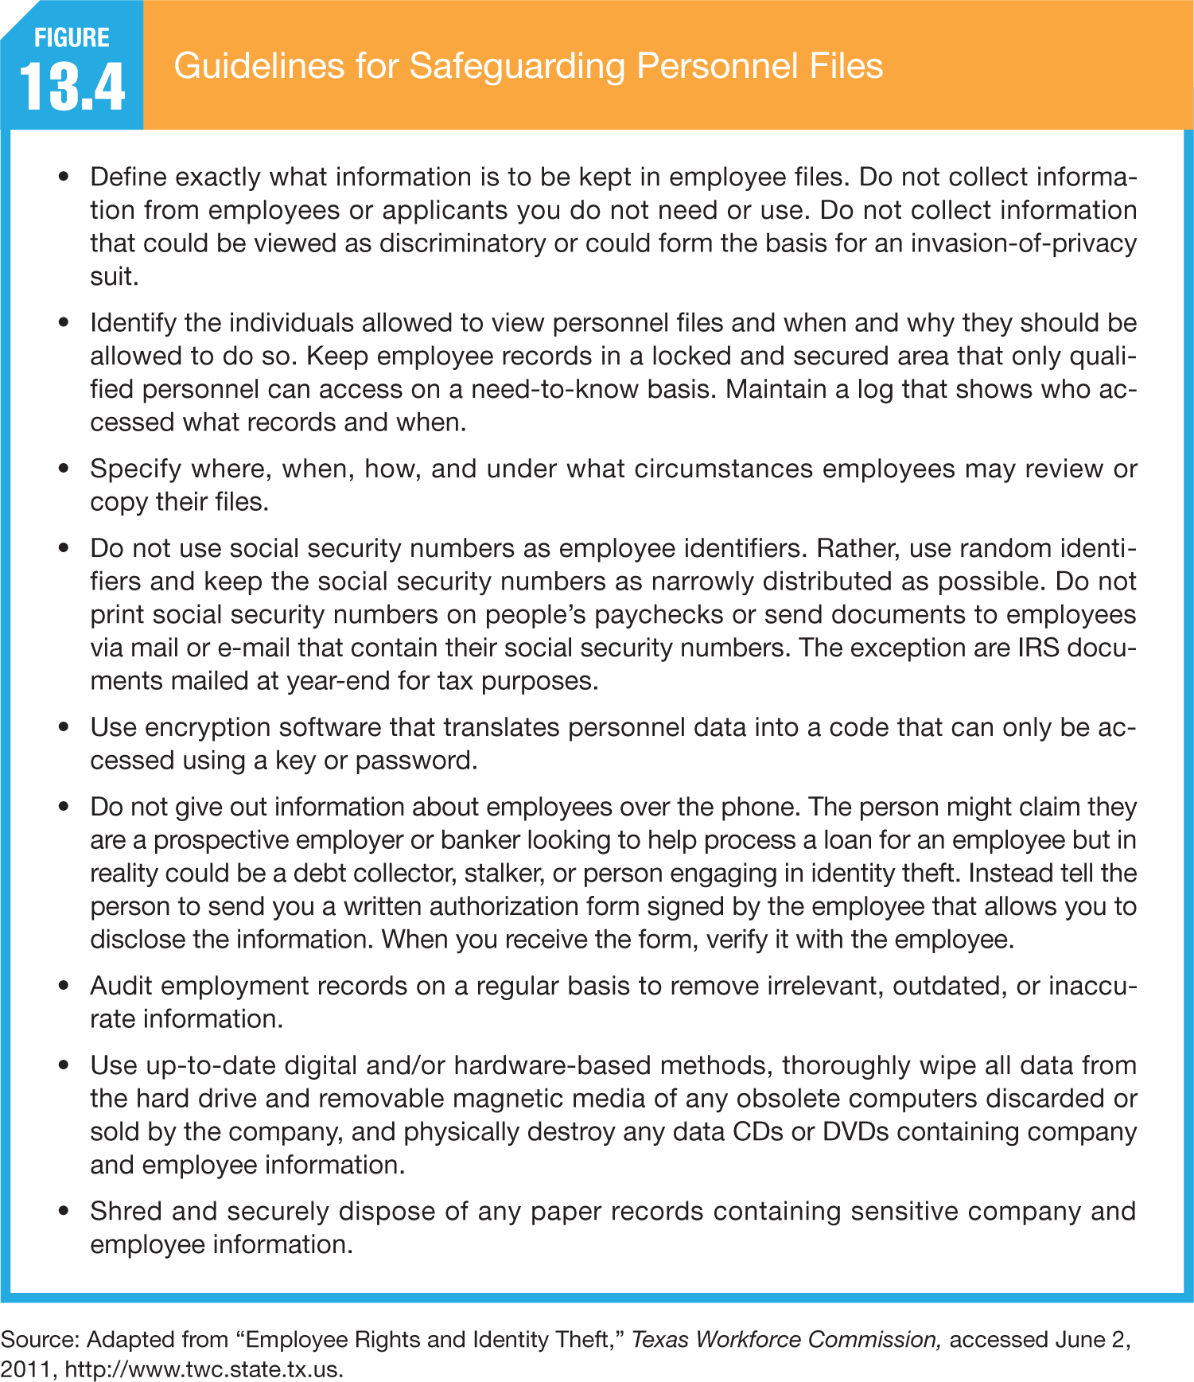

Slide 42
Employee Rights and Personal Behavior
Body Appearance
Off-Duty Behavior
An employer can place legitimate job-related limits on an employee’s personal at-work appearance such as tattoos and body piercings.
An employer can discipline an employee if the employee’s off-the-job behavior puts the company in legal or financial jeopardy.
Notes:
May not apply to body appearance and weight discrimination.

Slide 43
Manhattan HS guidance counselor stripped of job over steamy-photo past
Should Ms. Webb have been discharged? Why or why not?
Can you make a case for wrongful discharge?
Should management have considered Tiffany’s past 12-year work record in education before deciding on discharge? Explain.

Slide 44
HR Magazine: Off Duty, Out of Work
http://www.shrm.org/Publications/hrmagazine/EditorialContent/Pages/0203hirschman.aspx
Notes:
The company prevailed in September, 2002 when a federal judge in New Orleans ruled that federal and state laws prohibiting sex discrimination do not apply to "transgendered" people—those whose gender identity does not consistently match their biological sex.
What would the situation be today???

Slide 45
Employee Off-Duty Conduct
Generally speaking, employers are not permitted to terminate employees for off-duty "lawful activity" like consuming alcohol, carrying a firearm or gambling, even when that conduct may be prohibited in the workplace itself.
A broad Colorado statute, §24-34-402.5, makes it unlawful discrimination for an employer to terminate an employee for engaging in any "lawful activity" while off-duty unless there is a bona fide occupational requirement, the restriction is reasonably and rationally related to the job, or it is necessary to avoid a conflict of interest.

Slide 46
Lawful activity? Coats v. Dish Network, LLC (in Colorado)
Brandon Coats claimed that Dish wrongfully terminated him from his employment after he tested positive for a component of marijuana in a random drug test at work.
Mr. Coats, who worked in Colorado where the use of medical marijuana is lawful, was a quadriplegic with a state-issued medical marijuana license. He argued that he never used marijuana on the job and that his use was, pursuant to state law, "lawful activity" that could not form the basis for his termination.
Dish argued that since marijuana use is still barred by federal law it cannot qualify as "lawful" and the court agreed – in order to be "lawful" under the statute, the activity must be acceptable under both federal and state law.
Notes:
303 P.3d 147 (2013) Brandon COATS, Plaintiff-Appellant, v. DISH NETWORK, L.L.C., Defendant-Appellee. Court of Appeals Nos. 12CA0595 & 12CA1704. Colorado Court of Appeals, Div. A. Announced April 25, 2013.
It is also unclear whether legal users will be protected from terminations, even when the use does not seem to affect job performance. The few court cases that have addressed the issue have not read the state laws to protect employees. However, at least two states, Arizona and Delaware, have passed laws that restrict the firing of medical-marijuana users to cases where the employee was impaired on the job.
If you have a valid prescription for marijuana, you may be wondering whether an employer can refuse to hire you based on a positive drug test for this legally prescribed drug. So far, the answer seems to be yes. The California Supreme Court has ruled that the state's medical marijuana law applies only to criminal prosecution, not to the workplace. The Oregon Supreme Court also found against the employee in a medical marijuana case, but didn't decide the ultimate question of whether an employee who is using prescribed marijuana for a disability is entitled to an accommodation for his or her drug use.

Slide 47
Off-Duty Conduct: Workplace Romance and Fraternization Policies
With the ever increasing number of hours Americans spend at work, many are finding romance at the workplace. What should the employer consider when deciding whether and to what extent it should control romantic relationships between supervisors and subordinates and among co-workers?

Slide 48
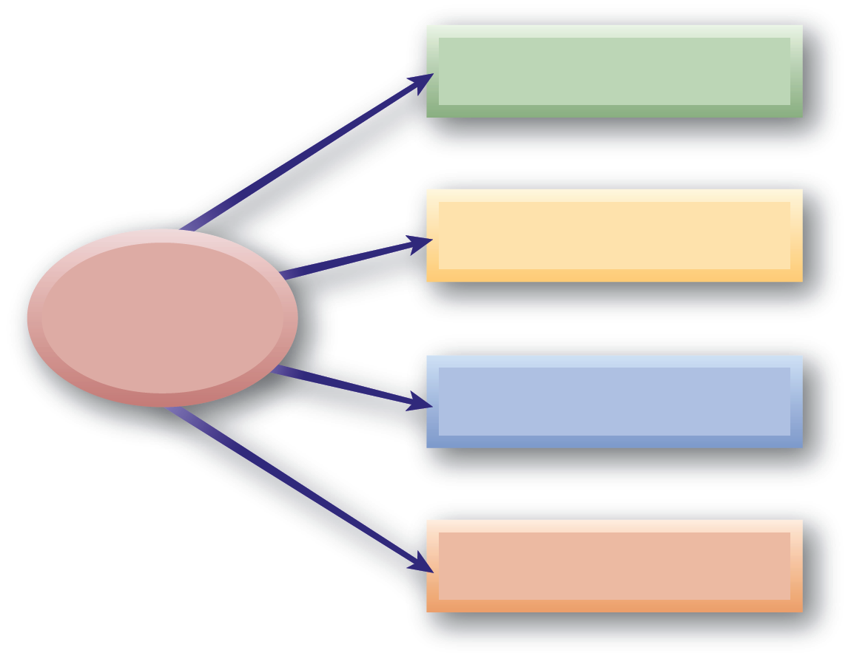
Balancing Employer Security and Employee Rights
Tracking Internet Use
Monitoring Employee Performance
Workplace Monitoring
Conducting Video Surveillance
Monitoring of E-Mail and Voice Mail

Slide 49
Workplace Monitoring
Right to Privacy
Freedom from unauthorized and unreasonable intrusion into personal affairs.
Privacy Rights and Employee Records:
Access to personal info held by employer
Response to unfavorable information in records
Correction of erroneous information
Prior notification when information is given to a third party

Slide 50
E-mail and Voice Mail
Electronic Communications Policy Elements
Voice mail, e-mail, and computer files are provided by employer for business use only.
Use of these media for personal reasons is restricted and subject to employer review.
All computer passwords and codes must be available to the employer.
The employer reserves right to monitor or search any of the media, without notice, for business purposes.

Slide 51
Cyberloafing …
The average U.S. employee with Internet access is spending 90 minutes a day visiting Web sites unrelated to his or her job
E-mailing friends
Shopping online
Stock trading
Searching for jobs
Playing games
Costing U.S. employers $54 billion a year in lost productivity
54% of employers monitor their employees’ Internet usage and 38% read their employees’ e-mail

Slide 52
Xerox As A Case In Point
Routinely monitors the Web activities of every one of its employees
Fired 40 workers because they were caught in the act of surfing to forbidden Web sites
Company’s monitoring software recorded the unauthorized visits to shopping and pornography sites and every minute they had spent at those sites

Slide 53
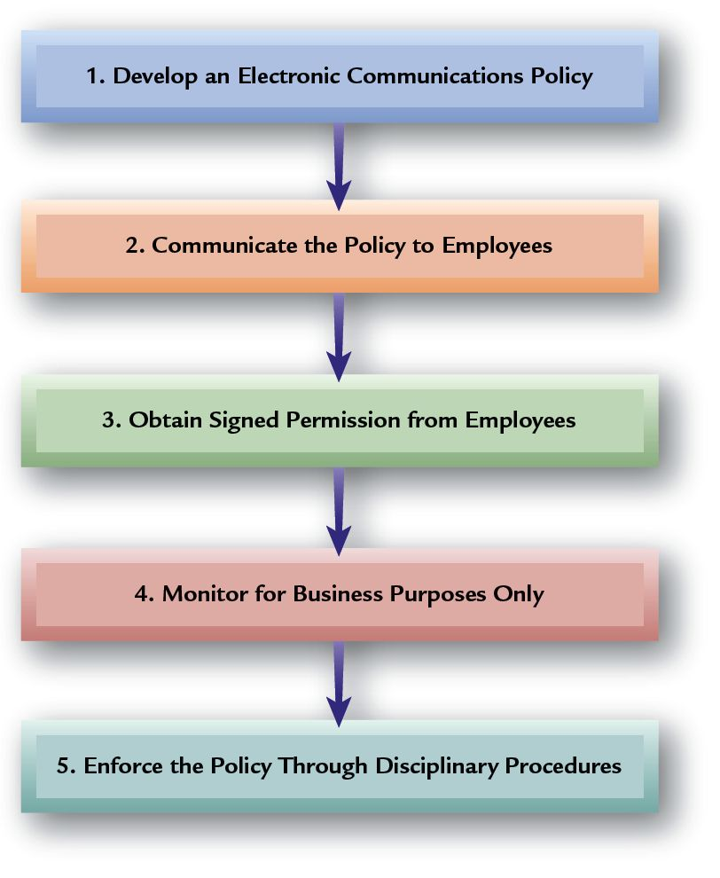
Recommended Employer Actions Regarding Electronic Communications

Slide 54
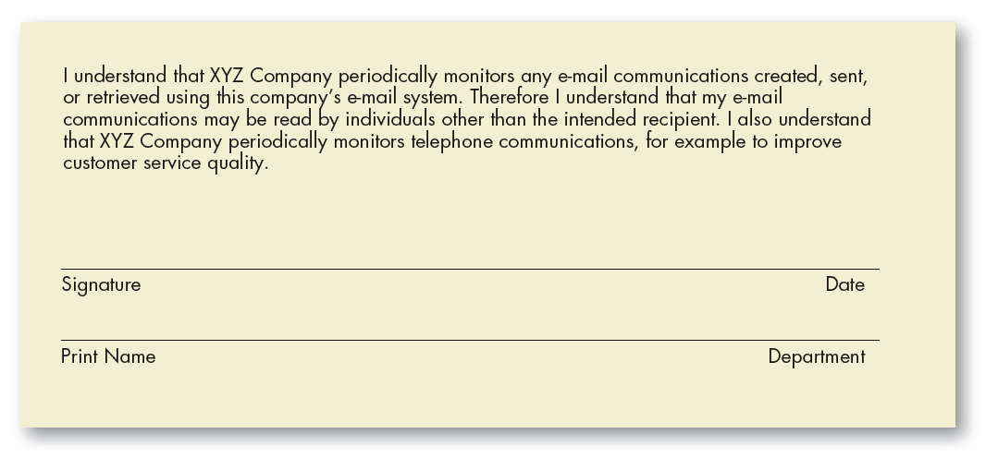
Sample Monitoring Acknowledgment Statement
Notes:
One recent U.S. Court of Appeals case suggests employers may have fewer rights to monitor e-mail than previously assumed. Employers should have employees sign e-mail and telephone monitoring acknowledgment statements like that in the above figure.

Slide 55
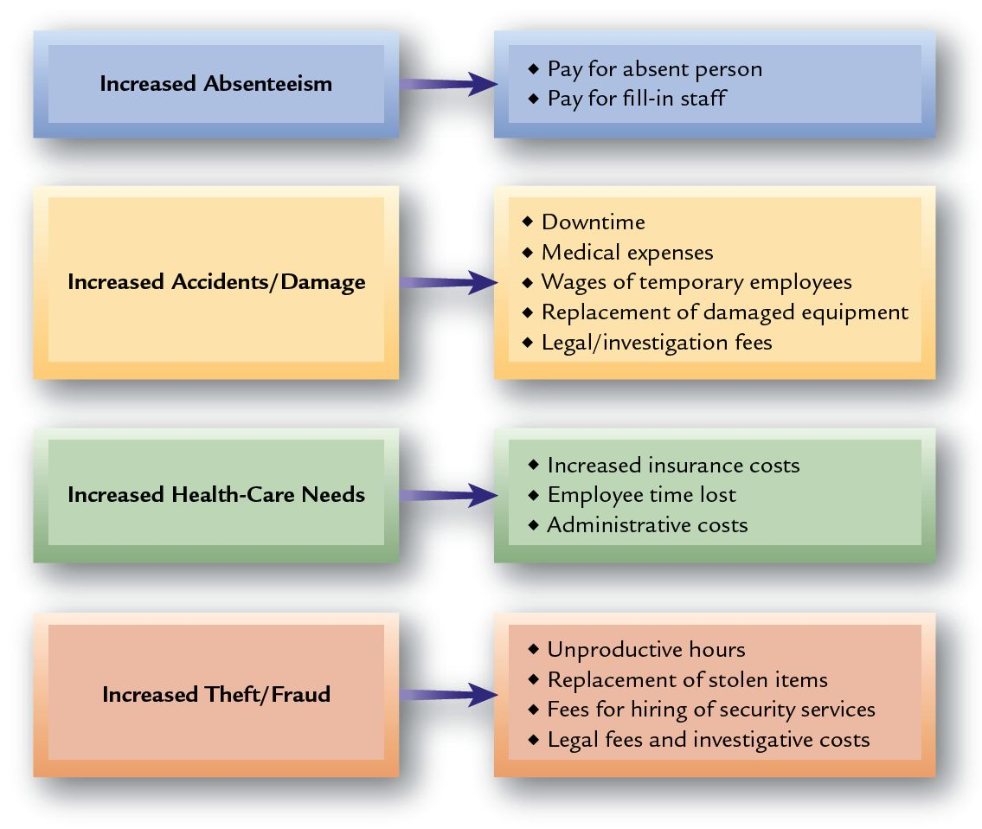
How Substance Abuse Affects Employers Financially

Slide 56
Substance Abuse and Drug Testing
Drug-Free Workplace Act of 1988
Requires government contractors to take steps to eliminate employee drug use.
Failure to comply may lead to contract termination.
Act does not cover tobacco and alcohol.
Off-the-job drug use not included.
U.S. Department of Transportation (DOT)
Requires regular testing of truck and bus drivers, train crews, mass-transit employees, airline pilots and mechanics, pipeline workers, and licensed sailors.

Slide 57
Drug Testing and Employee Rights
Policies for Conducting Drug Tests
Random testing of all employees at periodic intervals
Testing only in cases of probable cause
Testing after accidents
Testing Conditions
Job consequences outweigh privacy concerns.
Accurate test procedures are available.
Written consent of the employee is obtained.
Results are treated confidentially.
Employer has drug program, including an EAP.

Slide 58
Recommendations for a Drug-Free Workplace Polity

Slide 59
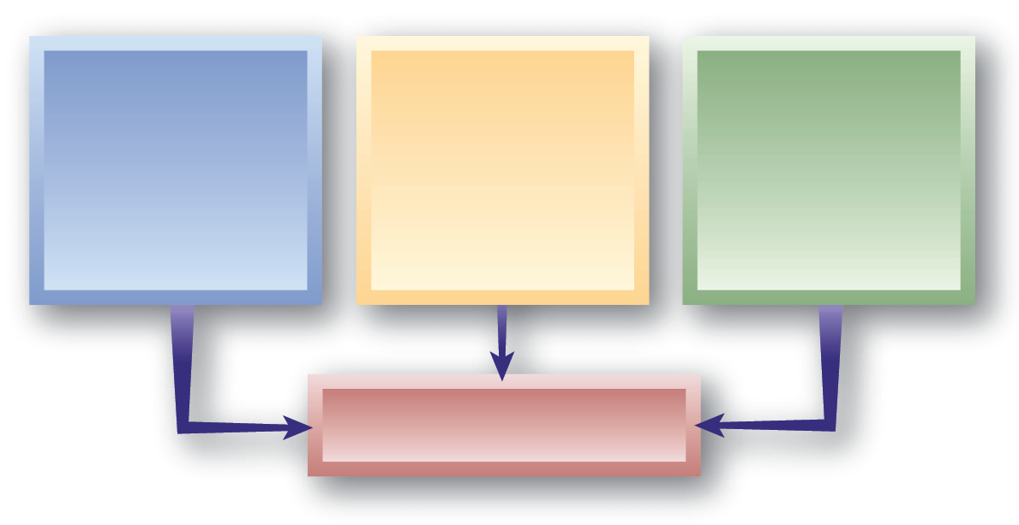
HR Policies, Procedures, and Rules
Policies
General guidelines that focus organizational actions.
"Why we do it"
Procedures
Customary methods of handling activities
"How we do it"
Rules
Specific guidelines that regulate and restrict the behavior of individuals.
"The limits on what we do"
Employee Rights

Slide 60
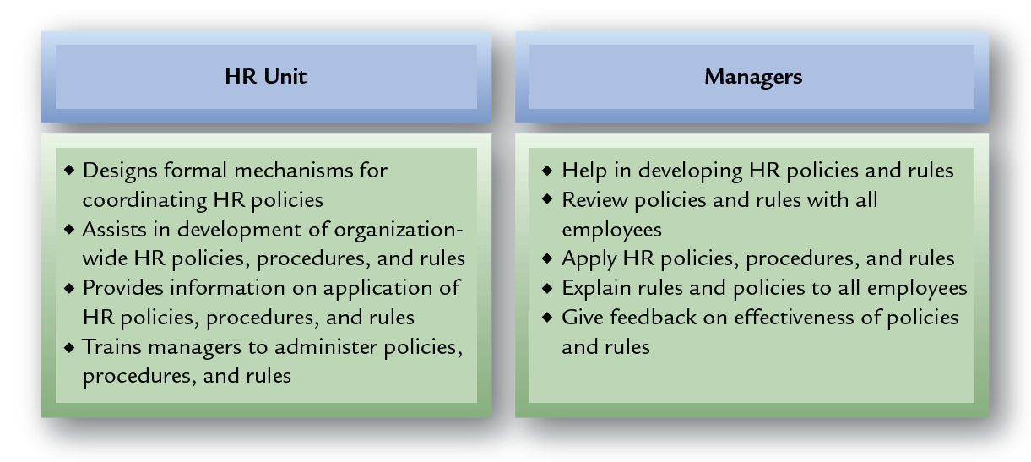
Typical Division of HR Responsibilities: Policies, Procedures, and Rules

Slide 61
Employee Handbooks
At-Will Prerogatives
Pay/Overtime
Harassment
Policies in Handbooks
Discipline
Electronic Communication
Benefits

Slide 62
Employee Handbooks
Legal Language
Eliminate controversial phrases in wording.
Use disclaimers disavowing handbook as a contract.
Keep handbook content current.
Readability
Make reading level appropriate for intended audience of employees.
Use
Communicate and discuss handbook.
Notify all employees of handbook changes.

Slide 63
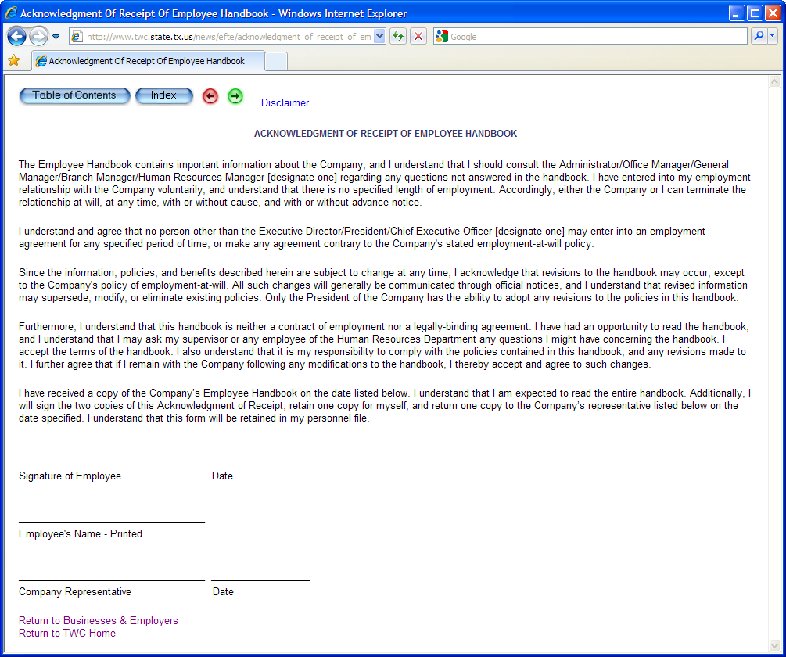
Handbook Acknowledgement Form
Notes:
This figure shows an acknowledgment form that applicants can sign indicating that they have received and reviewed the employee handbook.

Slide 64
Discipline and Disciplinary Action
Discipline: State of employee self-control and orderly conduct
Disciplinary action: Invokes penalty against employee who fails to meet established standards
Notes:
Discipline is the state of employee self-control and orderly conduct that indicates the extent of cooperation and compliance with an organization. A necessary aspect of internal employee relations is taking disciplinary action when employee conduct goes astray.
Disciplinary action invokes a penalty against an employee who fails to meet established standards. Even though disciplinary action may be unpleasant and fraught with conflict, at times it must be done.

Slide 65
Effective Disciplinary Action
Addresses employee’s wrongful behavior, not employee as a person
Should not be applied haphazardly
Not usually management’s initial response to a problem
Normally are more positive ways of convincing employees to adhere to company policies
Notes:
Disciplinary action should not usually be the first response to a problem, as there are more positive ways to encourage employees to uphold company policies and do what is right. If these initial approaches to the problem fail, only then should appropriate disciplinary action be taken to address the employee’s wrongful behavior. Incorrectly administered disciplinary action is destructive to both the employee and the organization.

Slide 66
The Disciplinary Action Process
EXTERNAL ENVIRONMENT
INTERNAL ENVIRONMENT
Set Organizational Goals
Establish Rules
Communicate Rules to Employees
Observe Performance
Compare Performance with Rules
Take Appropriate Disciplinary Action
Notes:
The disciplinary action process is depicted in this diagram. It is absolutely crucial that management take a proactive role in establishing and communicating rules if the organization wants to ensure that employees know what to do. After doing that, corrective action may need to be taken when an employee violates a rule. Note that the process includes feedback from the point of taking disciplinary action back to communicating rules to employees. This feedback is critical for the employee to understand whether his or her new behavior is acceptable or not.

Slide 67
Disciplinary Action
Word discipline comes from word disciple
Translated from Latin, it means to teach
Intent should be to ensure recipient sees disciplinary action as learning process
Notes:
The purpose of disciplinary action is to alter behavior that can have a negative impact on achievement of organizational objectives, not to punish the violator. Thus, the intent of disciplinary action should be to ensure that the recipient sees disciplinary action as a learning process rather than as something that inflicts pain.

Slide 68
Approaches to Disciplinary Action
Hot stove rule
Progressive disciplinary action
Positive, or nonpunitive, disciplinary action
Notes:
Several approaches to the administration of disciplinary action have been developed. Three of the most important concepts are the hot stove rule, progressive disciplinary action, and disciplinary action without punishment.

Slide 69
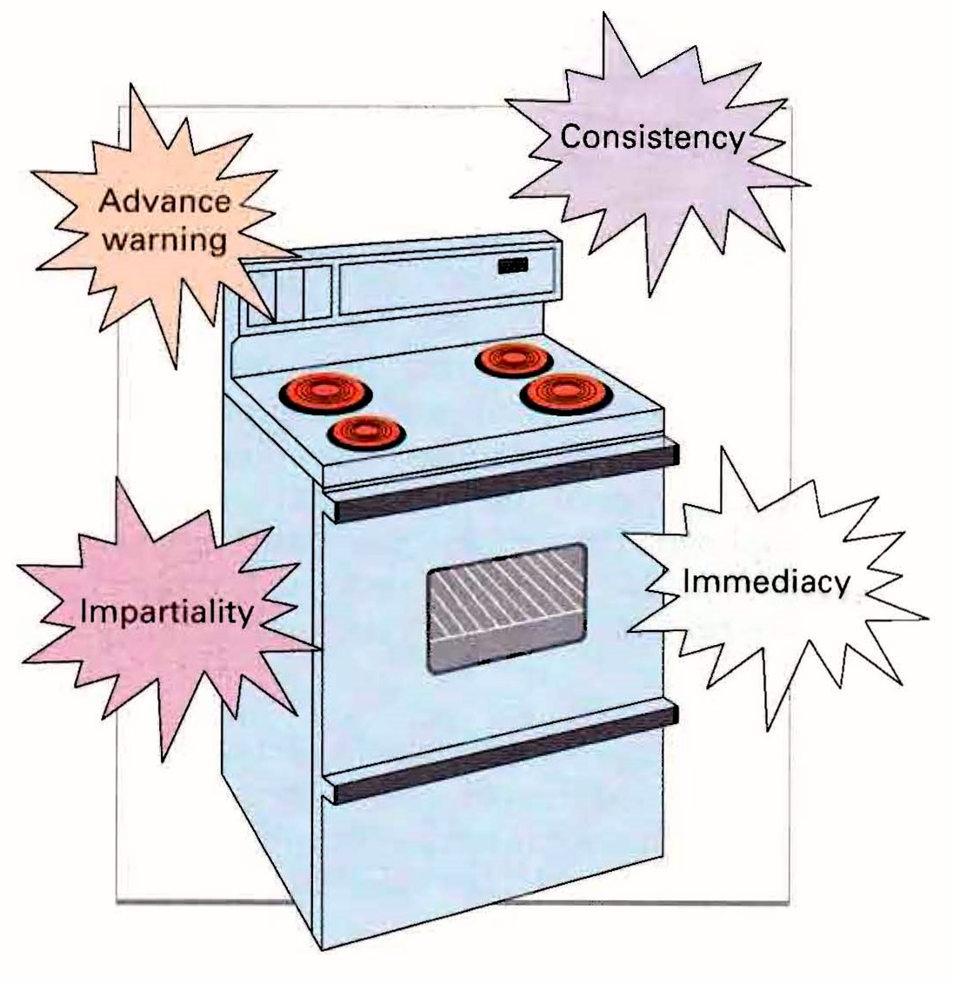
Hot Stove Rule
A set of principles for effectively disciplining an employee that demonstrates the analogy between touching a hot stove and receiving discipline.

Slide 70
Hot Stove Rule
Burns immediately
Provides warning
Gives consistent punishment
Burns impersonally
Problem: All situations are not the same
Notes:
According to the hot stove rule, disciplinary action should have the following consequences, which are analogous to touching a hot stove:
Burns immediately. If disciplinary action is to be taken, it must occur immediately so that the individual will understand the reason for it.
Provides warning. It is also extremely important to provide advance warning that punishment will follow unacceptable behavior.
Gives consistent punishment. Disciplinary action should also be consistent in that everyone who performs the same act will be punished accordingly.
Burns impersonally. Disciplinary action should be impersonal. The hot stove burns anyone who touches it, without favoritism.

Slide 71
Progressive Disciplinary Action
Ensures minimum penalty appropriate to offense is imposed
Model developed in response to National Labor Relations Act of 1935
Involves answering series of questions about severity of offense
Notes:
Progressive disciplinary action is intended to ensure that the minimum penalty appropriate to the offense is imposed. The progressive disciplinary model was developed in response to the National Labor Relations Act. The goal of progressive disciplinary action is to formally communicate problem issues to employees in a direct and timely manner so that they can improve their performance. Its use involves answering a series of questions about the severity of the offense that we will cover next.

Slide 72
The Progressive Disciplinary Approach
Improper Behavior
Yes
Does this violation warrant disciplinary actions?
No
No Disciplinary Action
Yes
Does this violation warrant more than an oral warning?
No
Oral Warning
Yes
Does this violation warrant more than a written warning?
No
Written Warning
Yes
Does this violation warrant more than a suspension?
No
Suspension
Yes
Termination
Notes:
This figure illustrates the questions a manager must ask to determine the proper disciplinary action. This process ensures that disciplinary actions are appropriate for the severity of the violation. For repeat violations of a lesser magnitude, there this is usually an escalation of disciplinary action. However, major violations, such as assaulting a supervisor or another worker, may justify immediate termination of the employee.

Slide 73
Suggested Guidelines for Disciplinary Action
Offenses Requiring First, an Oral Warning; Second, a Written Warning; and Third, Termination
Negligence in the performance of duties Unauthorized absence from job Inefficiency in the performance of job
Offenses Requiring a Written Warning; Second, Termination
Sleeping on the job Failure to report to work one or two days in a row without notification Negligent use of property
Offenses Requiring Immediate Termination
Theft Fighting on the job Falsifying time cards Failure to report to work three days in a row without notification
Notes:
To assist managers in recognizing the proper level of disciplinary action, some firms have established progressive disciplinary action guidelines, such as shown in this table. Specific guidelines should always be developed to meet the unique needs of the organization. For example, the wearing of rings or jewelry for aircraft mechanics is strictly prohibited due to safety concerns. However, there would likely be no such rule in an office environment. Basically, the rules should fit the needs of the work situation.

Slide 74
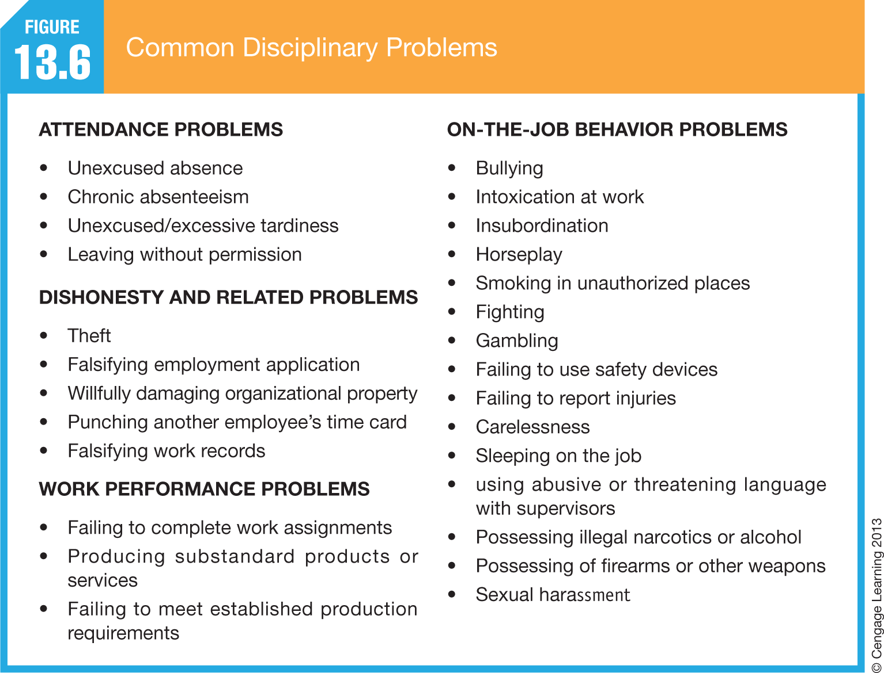
Disciplinary Policies and Procedures

Slide 75
Positive Disciplinary Action Nonpunitive Punishment
Process of giving worker time off with pay to think about whether he/she wants to follow rules and continue working for company
Employee violates rule, manager issues oral reminder
Repetition brings written reminder
Third violation: Worker takes 1-3 days off (with pay) to think about situation
Important that all rules are explicitly stated in writing
Notes:
The process of giving a worker time off with pay to think about whether he or she wants to follow the rules and continue working for the company is called positive disciplinary action without punishment. The approach throws out formal punitive disciplinary action policies for situations such as chronic tardiness or a bad attitude in favor of procedures that make employees want to take personal responsibility for their actions. It works something like this:
When an employee violates a rule, the manager issues an oral reminder.
A repeat violation brings a written reminder, and
A third violation results in the worker having to take one to three days off, with pay, to think about the situation.
If the third step is taken, upon the worker’s return, the worker and the supervisor meet to either agree that the employee will not violate the rule again or that the employee will leave the firm.

Slide 76
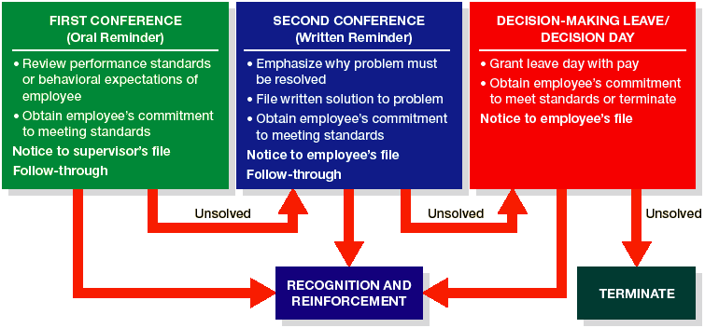
Positive Discipline thru Discharging Employees

Slide 77
Disciplinary Action Advice
Many supervisors may be too lenient early in disciplinary action process and too strict later
Proper time and place to administer disciplinary action is crucial
Managers often avoid disciplinary action, even when it is in company’s best interest
Notes:
Although the manager is usually in the best position to take disciplinary action, many would rather avoid it. This is partly human nature, but it may also stem from the fact that the manager may have previously overlooked similar performance issues. Many supervisors are too lenient early in the disciplinary action process and then too strict later on, when they don’t want to deal with the problem anymore. There should be consistency throughout the process to help the worker understand expectations and the consequences of inappropriate actions. The goal should always be to change behavior in a positive direction. Finally, when the decision to take disciplinary action against a worker has been made, there is a proper time and place for the meeting, and it should almost always occur in private.

Slide 78
Employee Discipline
Organizational culture of avoiding discipline
Fear of lawsuits
Lack of support by higher management
Reasons Why Managers Might Not Use Discipline
Avoidance of time loss
Guilt about past behavior
Fear of loss of friendship

Slide 80
Summary of Fair Discipline Guidelines
Make sure the evidence supports the charge.
Make sure the employee’s due process rights are protected.
Warn the employee of the disciplinary consequences.
Determine if the rule that was allegedly violated should be "reasonably related" to the efficient and safe operation of the work environment.
Investigate fairly and adequately the matter before administering discipline.
Conduct an investigation sufficient to uncover any substantial evidence of misconduct.
Apply all rules, orders, or penalties evenhandedly.
Apply a penalty that is reasonably related to the misconduct and to the employee’s past work.
Maintain the employee’s right to counsel.
Don’t rob a subordinate of his or her dignity.
Remember that the burden of proof is on you.
Get the facts. Don’t base a decision on hearsay or on your general impression.
Don’t act while angry.
In general, do not attempt to deal with an employee’s "bad attitude." Focus on improving the specific behaviors creating the workplace problem.
Notes:
This figure summarizes some useful fair discipline guidelines.

Slide 81
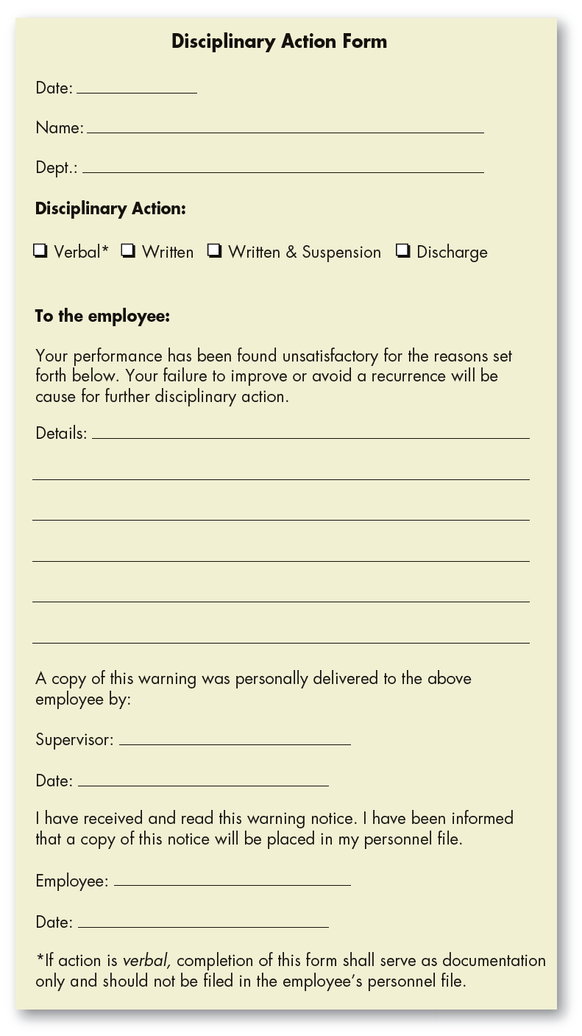
Disciplinary Action Form
Notes:
This figure is a sample form that a firm would use to issue a disciplinary warning to an employee.

Slide 82
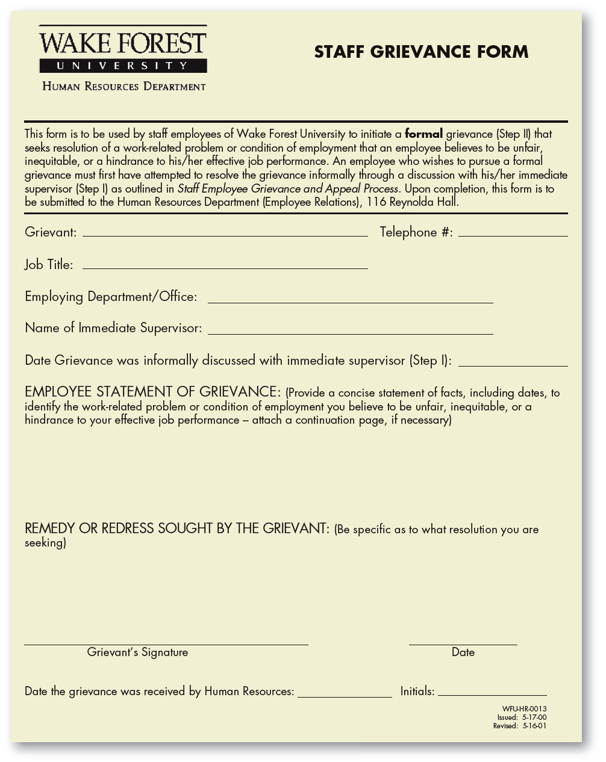
Grievance Form as Part of the Appeal Process
Notes:
This figure is a grievance form that is used in the appeals procedure for a disciplinary process.

Slide 83
Termination
Most severe penalty; should be most carefully considered
Termination of non-managerial and non-professional employees
Termination of executives
Termination of middle- and lower-level managers and professionals
Notes:
Termination is the most severe penalty that an organization can impose on an employee; therefore, it should be the most carefully considered form of disciplinary action. The experience of being terminated is traumatic for employees, regardless of their position in the organization. Not knowing how the terminated employee will react may also create considerable anxiety for the manager. An individual who is terminated may respond with violence or be unemotional in the matter. We will next review termination for different levels of employees.

Slide 84
Termination of Non-Managerial/ Non-Professional Employees
If firm is unionized, termination procedure is well defined in labor agreement.
Nonunion workers can generally be terminated more easily.
Notes:
Individuals in this category are neither managers nor professionally trained individuals, such as engineers or accountants. They generally include employees such as steelworkers, truck drivers, salesclerks, and wait staff. If the firm is unionized, the termination procedure is typically well defined in the labor–management agreement. When the firm is not unionized, these workers can generally be terminated more easily because they are most likely at-will employees. In most nonunion organizations, violations justifying termination are included in the firm’s employee handbook.

Slide 85
Termination of Executives
Economic
Reorganization
Downsizing
Philosophical differences
Decline in productivity
No formal appeals procedure
Notes:
Unlike workers at lower level positions, CEOs do not have to worry about their positions being eliminated. Their main concern is pleasing the board of directors, because hiring and firing the CEO is a board’s main responsibility. Often the reason for terminating a CEO is that the board of directors lost confidence in him or her. The reasons and process for termination of executives are usually not as clear as those for lower-level employees.

Slide 86
Termination of Middle- and Lower-Level Managers and Professionals
In past, most vulnerable and neglected group with regard to termination
Not members of union or protected by labor agreement
Notes:
Typically, the most vulnerable and perhaps the most neglected groups of employees with regard to termination have been middle and lower-level managers and professionals. Employees in these jobs may lack the political clout that a terminated executive has. Although certainly not recommended, termination may have been based on something as simple as the attitude or feelings of an immediate superior on a given day.

Slide 87
Outplacement
Laid-off employees are given assistance in finding employment elsewhere
Companies use outplacement to take care of employees by moving them successfully out of company
Firm tries to soften the impact of displacement
Notes:
In outplacement, laid-off employees are given assistance in finding employment elsewhere. Some of the services provided by outplacement include a discussion of pension options, Social Security benefits, expenses for interviews, and wage/salary negotiations. Usually career guidance is provided as well as instructions on how to conduct a self-appraisal directed toward recognizing skills, knowledge, experience, and other qualities recruiters may required in a new job. Tutoring in how to search for a job is usually available, and there is often help available in how to interview in the new employment environment.

Slide 88
Severance Pay
Compensation designed to assist laid-off employees as they search for new employment
No federal law requires severance
Between 70–80% of employers offer severance
Typically provide 1–2 weeks of severance pay for every year of service, up to some predetermined maximum
Notes:
Severance pay is compensation designed to assist laid-off employees as they search for new employment. Although no federal law requires U.S. companies to pay severance, between 70 and 80 percent of employers say that they offer severance to terminated employees. When offered, it typically provides one to two weeks of severance pay for every year of service, up to some predetermined maximum.

Slide 89
Worker Adjustment and Retraining Notification Act (WARN)
Requires covered employers to give 60 days advance notice before ordering plant closing or mass layoff
Generally include those with at least 100 full-time employees
Penalties for WARN notice violations include liability to each affected worker for back pay and benefits for up to 60 days
The law does not prevent the employer from closing down, nor does it require saving jobs
Notes:
The WARN Act requires covered employers to give 60 days advance notice before a plant closing or mass layoff that will affect a substantial number of workers. Covered employers generally include those with at least 100 full-time employees. There are severe monetary sanctions for failing to comply with the requirements of WARN, unless an unforeseeable business circumstance causes the business to close suddenly.

