Slide 1


Promoting Safety and Health
The Challenges of Human Resources Management

Slide 2
Safety and Health: It’s the Law
Consider these facts:
  In 2009, 3.6 million private-sectors workers suffered work-related injuries and illnesses.
  Back injuries, most of which occur because of improper lifting, are the nation’s no. 1 workplace safety problem. More than 1 million workers suffer back injuries each year.
  Each year the cost of occupational injuries and illnesses totals more than $156 billion.
  In 2009, 4,340 employees died from work accidents.
  Ninety percent of fatal work injuries involve workers in private industry.

Slide 3
AFL-CIO’s Annual “Death on the Job Report”
Found that, according to the U.S. Bureau of Labor Statistics, 4,693 workers were killed on the job — an average of 13 workers every day — and an estimated 50,000 died from occupational diseases in 2011.
Workers suffer… 7.6 million to 11.4 million job injuries and illnesses each year.
The cost of job injuries and illnesses is enormous — estimated at $250 billion to $300 billion a year.
The risk of job fatalities and injuries is not evenly distributed throughout the country. North Dakota workers experienced 12.4 fatalities per 100,000 workers while those in New Hampshire only experience 1.2 fatalities per 100,000 workers; OK had 8.3
Latino workers continue to be at increased risk of job fatalities, with a fatality rate of 4 per 100,000 workers in 2011.
Notes:
http://www.ok.gov/health2/documents/SSP_2010-2015_Occupational_Injuries.pdf reported that for 2007 Oklahoma had 8.3 deaths per 100,000 workers

Slide 4
The 10 Deadliest Jobs
1. Logging workers
2. Fishers and related fishing workers
3. Aircraft pilot and flight engineers
4. Roofers
5. Structural iron and steel workers
6. Refuse and recyclable material collectors
7. Electrical power-line installers and repairers
8. Drivers/sales workers and truck drivers
9. Farmers, ranchers, and other agricultural managers
10. Construction laborers

Slide 5
Occupational injuries in Oklahoma
http://www.ok.gov/health2/documents/SSP_2010-2015_Occupational_Injuries.pdf

Slide 6
Occupational Safety Law
Occupational Safety and Health Act
  The law passed by Congress in 1970 to assure so far as possible safe and healthful working conditions and to preserve human resources.
Occupational Safety and Health Administration (OSHA) and National Institute for Occupational Safety and Health (NIOSH)
  The agency created within the Department of Labor to set safety and health standards for almost all workers in the United States.
  Created National Institute for Occupational Safety & Health (NIOSH)
Notes:
Congress passed the Occupational Safety and Health Act of 1970 “to assure so far as possible every working man and woman in the nation safe and healthful working conditions and to preserve our human resources.”
The only employers it doesn’t cover are self-employed persons, farms in which only immediate members of the employer’s family work, and some workplaces already protected by other federal agencies or under other statutes. The act covers federal agencies, but usually not state and local governments.
The act created the Occupational Safety and Health Administration (OSHA) within the Department of Labor. OSHA’s basic purpose is to administer the act and to set and enforce the safety and health standards that apply to almost all workers in the United States. The Department of Labor enforces the standards, and OSHA has inspectors working out of branch offices to ensure compliance.
NIOSH is the U.S. federal agency responsible for conducting research and making recommendations for the prevention of work-related injury and illness. NIOSH is part of the Centers for Disease Control and Prevention (CDC) within the U.S. Department of Health and Human Services. NIOSH was established to help ensure safe and healthful working conditions by providing research, information, education, and training in the field of occupational safety and health. NIOSH provides national and world leadership to prevent work-related illness, injury, disability, and death by gathering information, conducting scientific research, and translating the knowledge gained into products and services.

Slide 7
OSHA (Dallas Morning News Article, (11/24/13)
“We’re a small agency with a big job. We can’t be in every company everyday.” OSHA spokesman Jesse Lawder.
Covers 100 million people in as many as 8 million workplaces
It’s entire staff in fiscal 2014 is 2,258—smaller than the enrollment of a typical suburban high school; 1,539 are designated for enforcement; Dallas Police Department has about 3,500 officers
2014 budget = $571M; would run the EPA for about 25 days; Voice of America budget $723M; payments to tobacco farmers =$960M
Its enforcement seems like Whac-A-Mole—a response only after problems arise

Slide 8
OSHA (Dallas Morning News Article, (11/24/13)
Current focuses include
  Refineries
  Chemical plants
  Construction (most dangerous work)

Slide 9
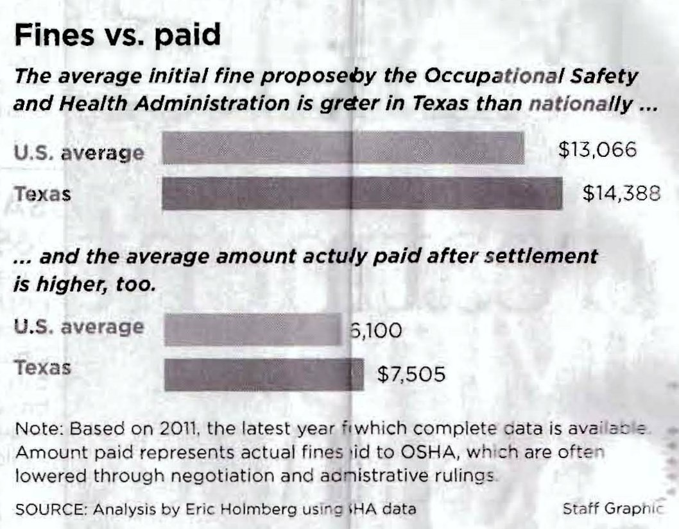
OSHA (Dallas Morning News Article, (11/24/13)

Slide 10
Recent significant accidents…
What happened at Chernobyl? When?
What happened at West Fertilizer Co? When?
What happened at the BP Deepwater Horizon oil spill? When?
What happened at the BP Texas City plant? When?
Notes:
Chernobyl, Ukraine in the former USSR, April 26, 1986; a surge of power caused a nuclear reactor meltdown
--31 people killed; from 1986 to 2000, 350,400 people were evacuated and resettled
--widely considered to have been the worst nuclear power plant accident in history
2) West Fertilizer accident occurred on 4/17/1013; Fire and explosion
--No federal inspector had shown up for 28 years
--Tons of ammonium nitrate blew up
--15 people killed
3) Deepwater Horizon oil spill or the British Petroleum (BP) oil spill occurred on April 20, 2010
--Oil drilling rig in the Gulf of Mexico 40 miles off southeast coast of Louisiana exploded and sank
--killed 11 people and injured another 16
--massive oil spill (gusher flowed for 87 days [capped on July 15, 2010] and spilled an estimated 210M gallons) that still is problematic for
Louisiana, Mississippi, Alabama, and Florida
--considered the largest accidental marine oil spill in the world, and the largest environmental disaster in U.S. history.
--As of February 2013, criminal and civil settlements and payments to a trust fund had cost the company $42.2B.
--agreed to pay $4.5B in fines (could have been $21B)
4) BP Texas City refinery plant explosion on March 23, 2005
--15 people killed; 170 injured
--On October 30, 2009, OSHA imposed an $87 million fine on the company; On August 12, 2010, BP announced that it had agreed to pay
$50.6 million of the October 30 fine, while continuing to contest the remaining $30.7 million.

Slide 11
10 Ways To Get into Trouble with OSHA
Ignore or retaliate against employees who raise safety issues.
Antagonize or lie to OSHA during an inspection.
Keep inaccurate OSHA logs and have disorganized safety files.
Do not correct hazards OSHA has cited you for and ignore commonly cited hazards.
Fail to control the flow of information during and after an inspection.
Do not conduct a safety audit, or identify a serious hazard
and do nothing about it.
Do not use appropriate engineering controls.
Do not take a systemic approach toward safety.
Do not enforce safety rules.
Ignore industrial hygiene issues

Slide 12
Responsibilities and Rights of Employers
Employer Responsibilities
  To meet the duty to provide “a workplace free from recognized hazards.”
  To be familiar with mandatory OSHA standards.
  To examine workplace conditions to make sure
  they conform to applicable standards.
Employer Rights
  To seek advice and off-site consultation from OSHA.
  To request and receive proper identification of the OSHA compliance officer before inspection.
  To be advised by the compliance officer of the reason
  for an inspection.
Notes:
Employers have responsibilities and rights under the Occupational Safety Health Act.

Slide 13
Responsibilities and Rights of Employees
Employee Responsibilities
  To comply with all applicable OSHA standards.
  To follow all employer safety and health rules and regulations.
  To report hazardous conditions to the supervisor.
Employee Rights
  The right to demand safety and health on the job
  without fear of punishment.
OSHA cannot cite employees for violations of their responsibilities.
Notes:
OSHA can’t cite employees for violations of their responsibilities. Employees are responsible, for example, for complying with all applicable OSHA standards, for following all employer safety and health rules and regulations, and for reporting hazardous conditions to the supervisor.

Slide 14
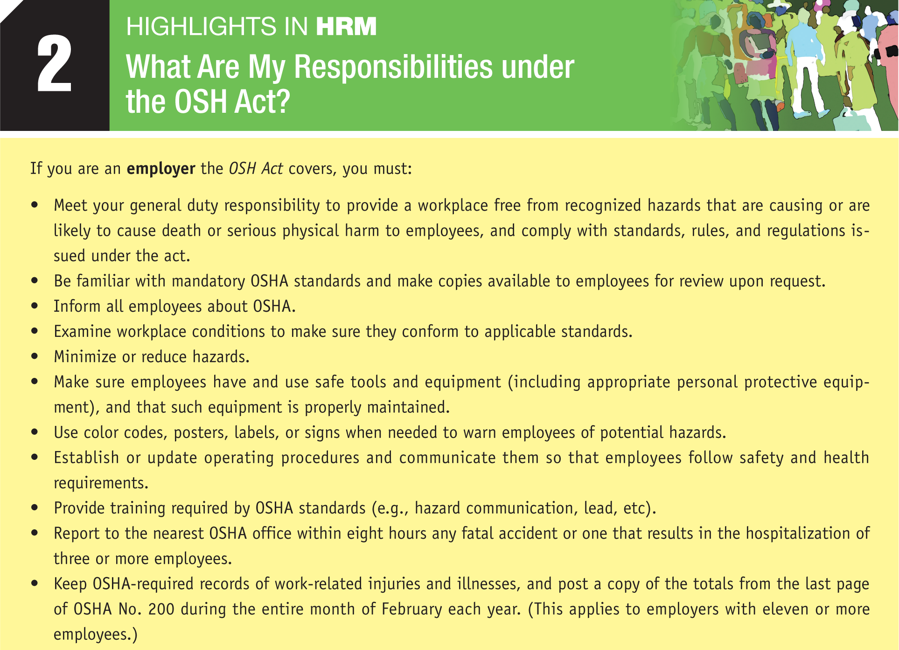

Slide 15
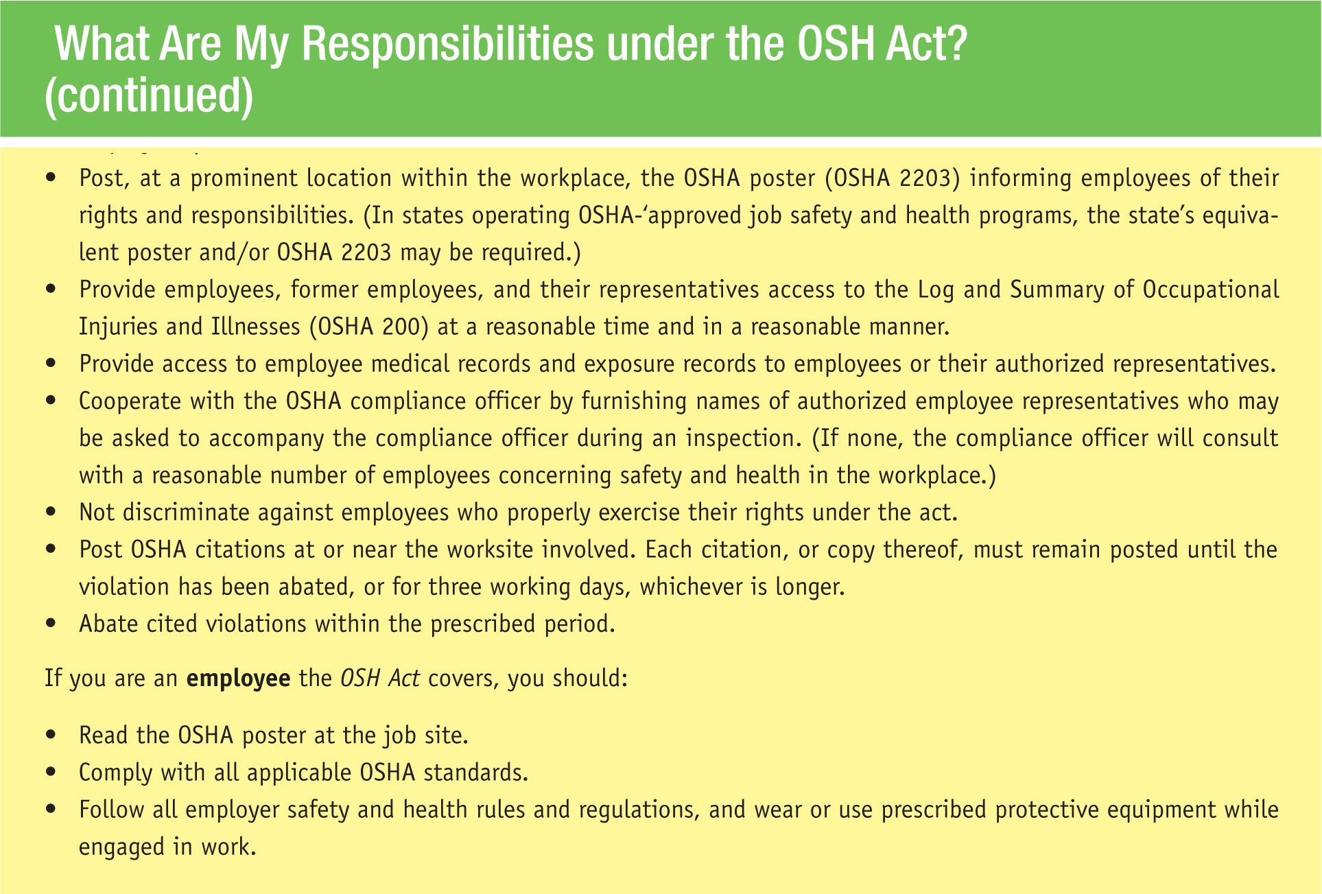
What are my responsibilities under the
OSHA Act? (cont.)

Slide 16
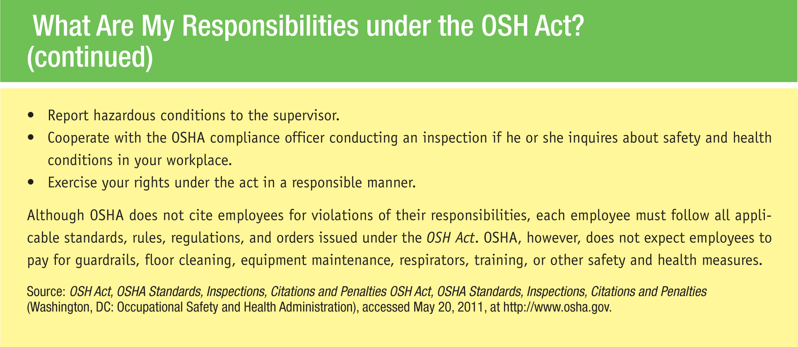
What are my responsibilities under the
OSHA Act? (cont.)

Slide 17
OSHA Record Keeping and Standards
Record Keeping
  Employers with 11 or more employees must maintain records of, and report, occupational injuries and occupational illnesses.
  Occupational illness
    Any abnormal condition or disorder caused by exposure
    to environmental factors associated with employment.
OSHA Standards
  OSHA sets general industry standards, maritime standards, construction standards, other regulations and procedures,
  and issues a field operations manual.
Notes:
To carry out its mission, OSHA is responsible for promulgating legally enforceable standards. These are contained in five volumes covering general industry standards, maritime standards, construction standards, other regulations and procedures, and a field operations manual.

Slide 18
OSHA Standards Example
Guardrails not less than 2” × 4” or the equivalent and not less than 36” or more than 42” high, with a midrail, when required, of a 1” × 4” lumber or equivalent, and toeboards, shall be installed at all open sides on all scaffolds more than 10 feet above the ground or floor. Toeboards shall be a minimum of 4” in height. Wire mesh shall be installed in accordance with paragraph [a] (17) of this section.
NIOSH (National Institute for Occupational Safety and Health) is a major source of standards, although recommendations come from employers, unions, and other sources.
Notes:
This figure presents a small part of the standard governing guardrails for scaffolds.
As part of the Centers for Disease Control, NIOSH (National Institute for Occupational Safety and Health) is responsible for conducting research and making recommendations for the prevention of work-related illnesses and injuries.

Slide 19
General Duty Clause
https://www.osha.gov/pls/oshaweb/owadisp.show_document?p_id=3359&p_table=OSHACT
The courts have interpreted OSHA’s general duty clause to mean that an employer has a legal obligation to provide a workplace free of conditions or activities that either the employer or industry recognizes as hazardous and that cause, or are likely to cause, death or serious physical harm to employees when there is a feasible method to abate the hazard.

Slide 20
General Duty Clause cont’d
It is a catch-all obligation for employers aside from what OSHA says on an issue. “Employers can’t be limited to [OSHA standards] in terms of their overall approach to safety and health.”
Several conditions must be met for OSHA to issue a General Duty Clause violation:
  The hazard was recognized.
  The employer failed to keep the workplace free of a hazard to which his or her employees were exposed.
  A feasible and useful method was available to correct the hazard.
  The hazard was causing or likely to cause death or serious injury.

Slide 21
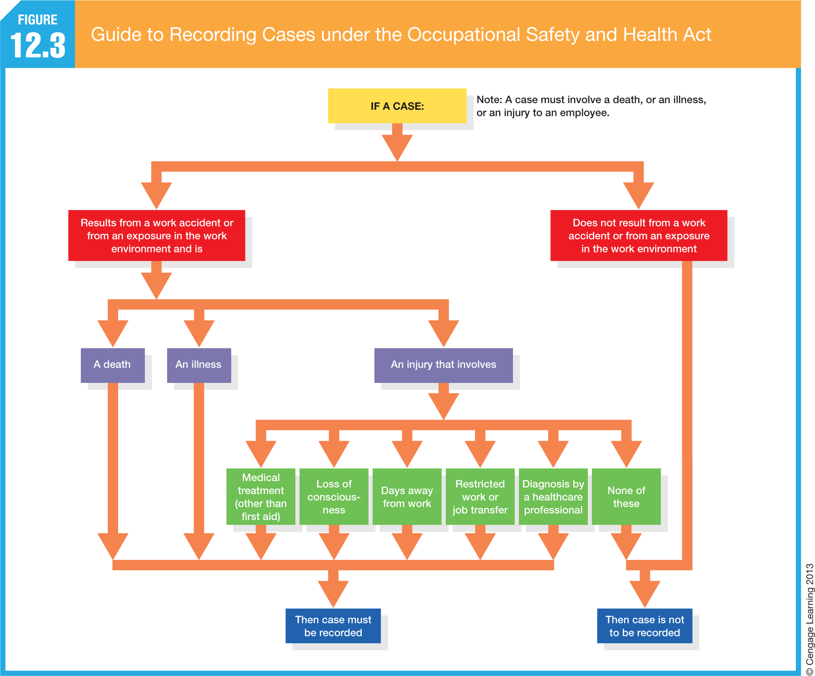
Notes:
As summarized in this figure, employers must report all occupational illnesses and recordable injuries.

Slide 22
Investigating and Recording Accidents
Recordable Case
  Any occupational death, illness, or injury to be recorded in the log (OSHA Form 300).
  Recordable accidents include: death, days away from work, restricted work or transfer to another job, or medical treatment beyond first aid.
  Other problems include loss of consciousness or diagnosis of a significant injury or illness by a healthcare professional.

Slide 23
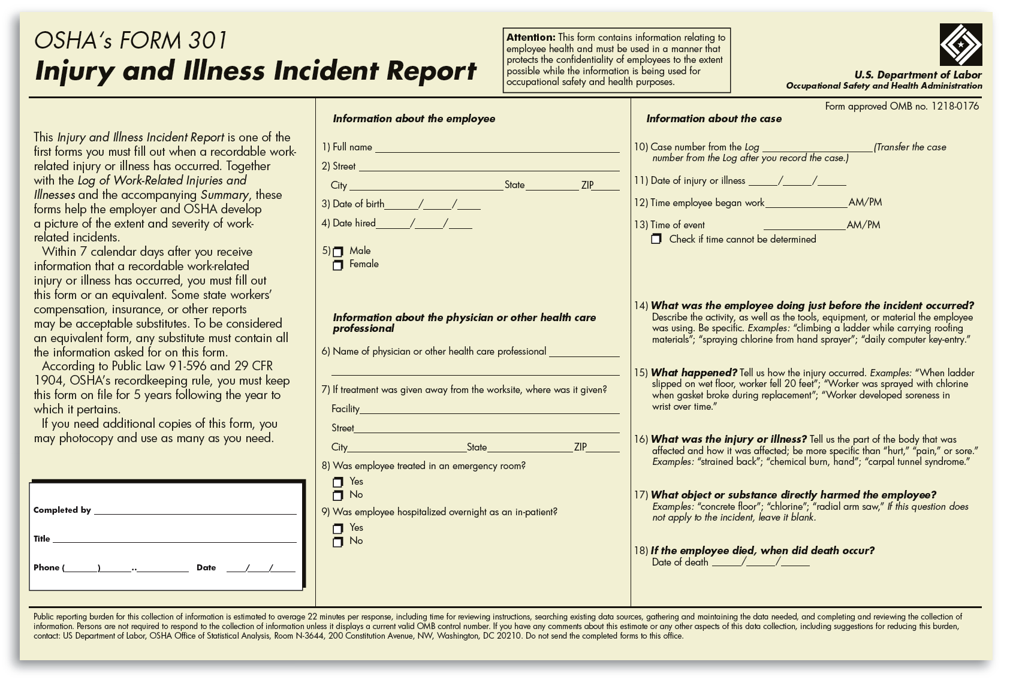
Form Used to Record Occupational Injuries and Illnesses
Notes:
This figure shows the OSHA form for reporting occupational injuries or illness.

Slide 24
OSHA Inspection Priorities
Inspections of imminent danger situations
Inspections of catastrophes, fatalities, and
accidents that have already occurred
Inspections related to valid employee complaints
of alleged violation standards
Periodic, special-emphasis inspections aimed at high-hazard industries, occupations, or substances
Random inspections and reinspections
Notes:
OSHA enforces its standards through inspections and (if necessary) citations. The inspection is usually unannounced. OSHA may not conduct warrantless inspections without an employer’s consent. However, it may inspect after acquiring an authorized search warrant or its equivalent.

Slide 25
Citations and Penalties
Citation
  Is a summons informing employers and employees of the regulations and standards that have been violated in the workplace.
Penalties
  Are calculated based on the gravity of the violation and usually take into consideration factors like the size of the business, the firm’s compliance history, and the employer’s good faith.
  Violations
    Other-Than-Serious (<$7K
    Serious ($3-4K average)
    Willful (up to $70K)
Notes:
OSHA inspectors can issue citations and impose penalties.

Slide 26
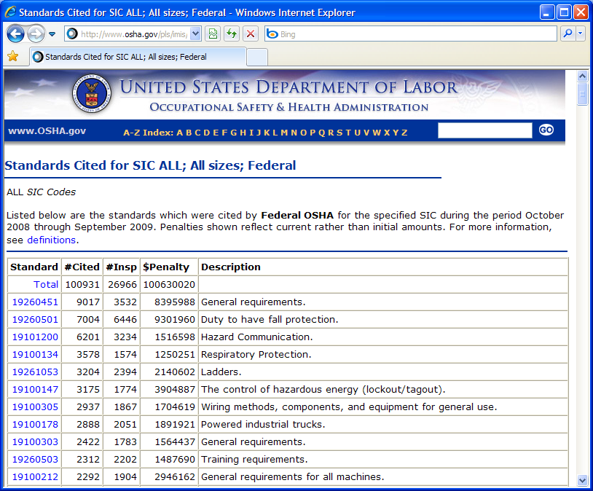
Most Frequently Cited Hazards
Notes:
This figure lists the hazards that accounted for the greatest number of citations in one recent year. Inadequate scaffolding/fall protection was one of the most frequently cited hazards.

Slide 27
Inspection Guidelines
Initial Contact
  Refer inspector to the company’s OSHA coordinator.
  Check inspector’s credentials.
  Ask inspector why he or she is inspecting the workplace: Complaint? Regular scheduled visit? Fatality or accident follow-up? Imminent danger?
  If the inspection stems from a complaint, you are entitled to know whether the person is a current employee, though not the person’s name.
  Notify your counsel.
Notes:
Guidelines for what a manager should do when OSHA inspectors unexpectedly show up.

Slide 28
Inspection Guidelines (cont’d)
Opening Conference
  Establish focus and scope of the planned inspection.
  Discuss procedures for protecting trade secret areas.
  Show inspector that you have safety programs in place.
  He or she may not go to the work floor if paperwork
  is complete and up to date.
Notes:
Guidelines for what a manager should do when conferencing with OSHA inspectors.

Slide 29
Inspection Guidelines (cont’d)
Walk-Around Inspection
  Accompany the inspector and take detailed notes.
  If inspector takes a photo or video, you should, too.
  Ask for duplicates of all physical samples and copies
  of all test results.
  Be helpful and cooperative, but don’t volunteer information.
  To the extent possible, immediately correct any violation
  the inspector identifies.
Notes:
Guidelines for what a manager should do when he or she is accompanying OSHA inspectors on a facility inspection.

Slide 30
What Causes Accidents?
Basic Causes
of Accidents
Chance occurrences
Unsafe
conditions
Employees’
unsafe acts
Notes:
There are three basic causes of workplace accidents: chance occurrences, unsafe conditions, and employees’ unsafe acts. Chance occurrences are more or less beyond management’s control.

Slide 31
Improperly guarded equipment
Improper ventilation
Defective equipment
Unsafe Conditions
Improper illumination
Hazardous procedures
Unsafe/Untidy
storage
Notes:
Unsafe conditions are a main cause of accidents. The solution here is to identify and eliminate the unsafe conditions.

Slide 32
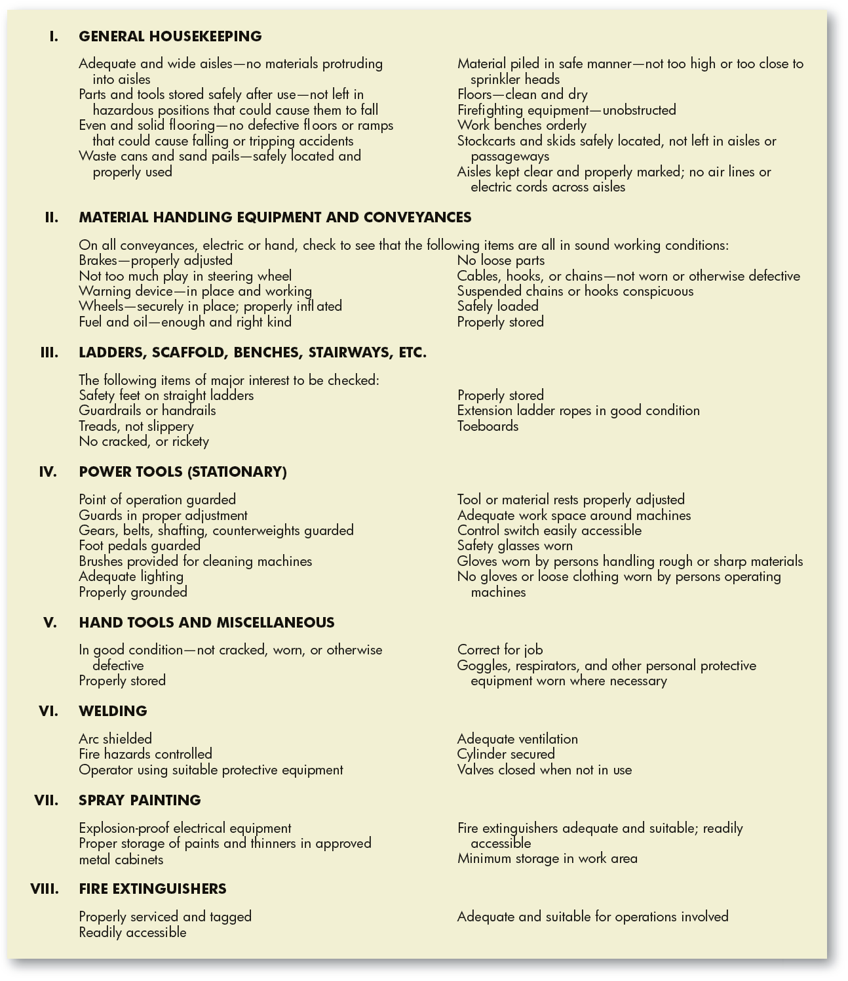
Checklist of
Mechanical or
Physical Accident-
Causing Conditions
Notes:
This figure presents a checklist that can help identify and remove potential hazards.

Slide 33

Reducing Unsafe Conditions and Acts: A Summary
Reduce Unsafe Conditions
Identify and eliminate unsafe conditions.
Use administrative means, such as job rotation.
Use personal protective equipment.
Reduce Unsafe Acts
Emphasize top management commitment.
Emphasize safety.
Establish a safety policy.
Reduce unsafe acts through selection.
Provide safety training.
Use posters and other propaganda.
Use positive reinforcement.
Use behavior-based safety programs.
Encourage worker participation.
Conduct safety and health inspections regularly.
Notes:
Reducing unsafe acts—by emphasizing safety and through screening, training, or incentive programs, for example—is the second basic way to reduce accidents. This table summarizes suggestions for reducing unsafe conditions and acts.

Slide 34
Workplace Exposure Hazards
Chemicals and other hazardous materials
Excessive noise and vibrations
Temperature extremes
Biohazards, including those that are normally occurring and man-made
Ergonomic hazards of poorly designed equipment that forces workers to do jobs while contorted in unnatural positions
Slippery floors and blocked passageways
Notes:
Typical workplace exposure hazards include chemicals and other hazardous materials, temperature extremes, biohazards, and ergonomic hazards.

Slide 35
OSHA Substance-Specific Health Standards
Substance Permissible Exposure Limits
Asbestos .1001
Vinyl chloride .1017
Inorganic arsenic .1018
Lead .1025
Cadmium .1027
Benzene .1028
Coke oven emissions .1029
Cotton dust .1043
1,2-Dibromo-3-chloropropane .1044
Acrylonitrile .1045
Ethylene oxide .1047
Formaldehyde .1048
4,4’-Methylene-dianaline .1050
Methylene chloride .1051
Notes:
Having identified a possible hazard, the evaluation phase involves determining how severe the hazard is. This requires measuring the exposure, comparing the measured exposure to some benchmark (as in this table), and determining whether the risk is within tolerances.

Slide 36
Infectious Diseases in the Workplace
Steps to prevent entry or spread of diseases:
  Closely monitor Centers for Disease Control and Prevention (CDC) travel alerts at www.cdc.gov.
  Provide daily medical screenings for employees
  returning from infected areas.
  Deny access to your facility for 10 days to employees
  or visitors returning from affected areas.
  Tell employees to stay home if they have a fever
  or respiratory system symptoms.
  Clean work areas and surfaces regularly.
  Stagger breaks. Offer several lunch periods
  to reduce overcrowding.
  Emphasize the importance of frequent hand washing
  and make sanitizers containing alcohol easily available.
Notes:
With many employees traveling to and from international destinations, monitoring and controlling infectious diseases has become an important safety issue. Employers can take steps to prevent the entry or spread of infectious diseases into their workplaces.

Slide 37
Incident Rate
Incidence Rate
  The number of injuries and illnesses per 100 full-time employees during a given year where 200,000 equals the base for 100 full-time workers who work forty hours a week, fifty weeks a year.
  Incidence rate =
    Number of injuries and illnesses × 200,000
    Total hours worked by all employees during the period covered

Slide 38

Safety Hazards and Issues
Fatigue
Distracted Driving

Slide 39
Safety Hazards and Issues (cont.)
Workplace Emergencies
  Floods
  Hurricanes
  Tornadoes
  Fires
  Toxic gas releases
  Chemical spills
  Radiological accidents
  Explosions
  Civil disturbances and terrorism
OSHA requires companies to have emergency action plans to deal with incidents such as these.

Slide 40
Evacuation Plans
Evacuation contingency plans should contain:
  Methods for early detection of a problem.
  Methods for communicating the emergency externally.
  Communications plans for initiating an evacuation.
  Communications plans for those the employer wants to evacuate that provide specific information about
  the emergency, and let them know what action they should take next.
Notes:
The possibility of emergencies prompted by fires, explosions, and similar issues means that employers need facility notification and evacuation plans. Such plans should contain the several elements listed in this slide.

Slide 41
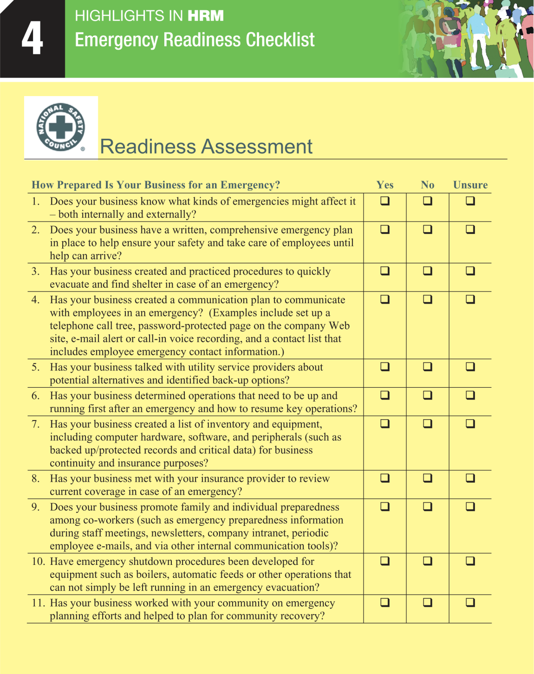

Slide 42
Safety Hazards and Issues (cont.)
Crisis Management Teams
  Composed of hourly and managerial employees
  Work in conjunction with HR to conduct initial risk assessment surveys
  Develop emergency action plans
  Perform crisis intervention during emergency events
Mandate
  Gather facts about threat
  Decide if organization should intervene
  Determine most appropriate method

Slide 43
Occupational Security and Safety
Basic Prerequisites for Crime Prevention Plan
  Company philosophy and policy on crime
  Investigations of job applicants
  Security awareness training
  Crisis management
Setting Up a Basic Security Program
  Analyzing the current level of risk
  Installing natural, mechanical, and
  organizational security systems
Notes:
Ideally, a comprehensive corporate anticrime program should start with these basic actions. In simplest terms, actually instituting a basic facility security program requires four steps: analyzing the current level of risk, and then installing mechanical, natural, and organizational security systems.

Slide 44
Assessing Current Level of Risk
Access to
reception area
Mail
handling
Initial Threat Assessment
Interior
security
Evacuation procedures
Authorities involvement
Data backup systems
Notes:
As part of this initial threat assessment, managers should review at least these six matters.

Slide 45
Company Security and Employee Privacy
To investigate employees for potential security breaches:
  Distribute a policy that says the firm reserves the right to inspect and search employees, their personal property, and all company property.
  Train investigators to focus on the facts and avoid making accusations.
  Make sure investigators know that employees can request that an employee representative be present during the interview.
  Make sure all investigations and searches
  are evenhanded and nondiscriminatory.
Notes:
Employers must consider employee privacy when using monitoring to control or investigate possible employee security breaches. Employers should get employees’ consent for monitoring when employees sign for receipt of company handbooks during orientation. The employer may also use monitoring if it is clear from its policies and notices that employees should have known that monitoring might take place.

Slide 46
Safety Hazards and Issues
Workplace Violence
  Any physical assault, threatening behavior, or verbal abuse occurring in the work setting. It includes, but is not limited to, beatings, stabbings, suicides, shootings, rapes, near suicides, psychological traumas such as threats, obscene phone calls, an intimidating presence, and harassment of any nature such as being followed, sworn at, or shouted at.
According to OSHA, more than two million nonfatal workplace violence incidents are reported annually in the form of assaults, robberies, thefts, hostage takings, hijackings, rapes, and sexual attacks.

Slide 47
Violence at Work
  Steps to Reduce Workplace Violence:
  Institute heightened security measures
  Improve employee screening
  Provide workplace violence training
  Provide organizational justice
  Pay enhanced attention to employee retention/dismissal
  Take care when dismissing violent employees
  Deal promptly with angry employees
  Understand the legal constraints on reducing workplace violence
Notes:
Employers can take several steps to reduce workplace violence.

Slide 48
Identifying Potentially Violent Employees
An act of violence on or off the job
Erratic behavior evidencing a loss of awareness of actions
Overly defensive, obsessive, or paranoid tendencies
Overly confrontational or antisocial behavior
Sexually aggressive behavior
Isolationist or loner tendencies
Insubordinate behavior with a suggestion of violence
Tendency to overreact to criticism
Exaggerated interest in war, guns, violence, catastrophes
The commission of a serious breach of security
Possession of weapons, guns, knives at the workplace
Violation of privacy rights of others
Chronic complaining and frequent, unreasonable grievances
A retribution-oriented or get-even attitude
Notes:
Employers also need effective procedures for identifying and dealing with potentially lethal employees. Start with adopting a workplace violence policy that outlines unacceptable employee behavior and a zero-tolerance policy toward workplace violence. Behaviors that managers should watch out for are listed in this slide.

Slide 49
Perpetrators of Workplace Violence*
Male (80%)
Between the ages of 20 and 50 (usually in 40s)
Have their self-esteem tied to their job
Fond of violent films and TV Shows
Fascinated by guns
Have ready access to guns
Often subscribe to Soldier of Fortune magazine (http://www.sofmag.com/)
Usually described as loners
*Dietz, P. E. (1994). Overview of workplace violence. Seminar presented to SHRM, Roanoke, VA
Notes:
The U.S. Department of Labor defines workplace violence as “any threat or act of physical violence, harassment, intimidation, or other threatening disruptive behavior that occurs at [a] worksite.”

Slide 50
Dismissing Violent Employees
Analyze and anticipate, based on the person’s history, what kind
of aggressive behavior to expect.
Have a security guard nearby when the dismissal takes place.
Clear away furniture and things the person might throw.
Don’t wear loose clothing that the person might grab.
Don’t make it sound as if you’re accusing the employee; instead, say that according to company policy, you’re required to take action.
Maintain the person’s dignity and emphasize something good about the employee.
Provide job counseling for terminated employees, to help get the employee over the traumatic post-dismissal adjustment.
Consider obtaining restraining orders against those who have exhibited a tendency to act violently in the workplace.
Notes:
This slides lists precautions that managers should use when firing or disciplining potentially violent employees.

Slide 51
Dealing with Angry Employees
Make eye contact.
Stop what you are doing and give your full attention.
Speak in a calm voice and create a relaxed environment.
Be open and honest.
Let the person have his or her say.
Ask for examples of what the person is upset about.
Be careful to define the problem.
Ask open-ended questions/explore all sides of the issue.
Listen: Often, angry people simply want a supportive, empathic ear from someone they can trust.
Notes:
The slide offers some suggestions for what you should do when confronted by an angry, potentially explosive employee.

Slide 52
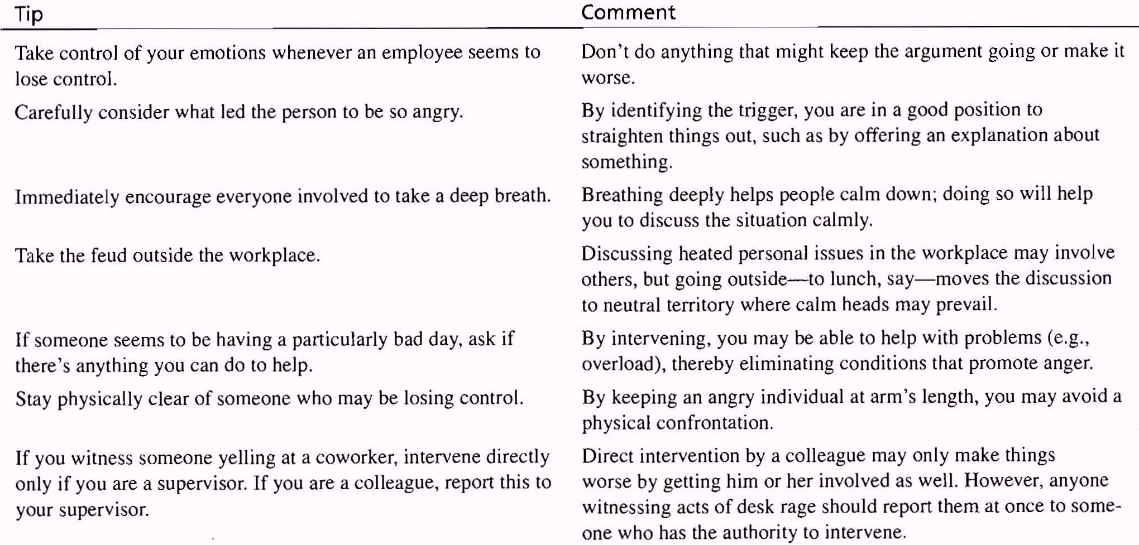
Addressing Desk Rage:
Useful Tips for Managers
Notes:
Source: Lorenz, I. (2004, December 20). 7 tips for combating desk rage. CNN.com/CareerBuilder.com Retrieved from http://www.cnn.com/2004/US/Careers/08/13/boss.spying/index.html

Slide 53
Workplace Smoking
  Costs
    Higher health and fire insurance costs
    Increased absenteeism
    Reduced productivity
    Secondhand smoke
  Remedies
    Ban smoking in the workplace
    Do not hire smokers
    Fire smokers who won’t quit
Notes:
Smoking is a serious health and cost problem for both employees and employers. For employers, these costs derive from higher health and fire insurance, as well as increased absenteeism and reduced productivity.

Slide 54
Banning Smokers – Is It Legal?
There’s no federal law that protects smokers or entitles them to equal protections when it comes to hiring, promotions, etc. That’s because the Equal Employment Opportunity Commission doesn’t recognize smokers as a protected class.
That said, there are 29 states (along with the District of Columbia) that do offer protections for smokers.

Slide 55
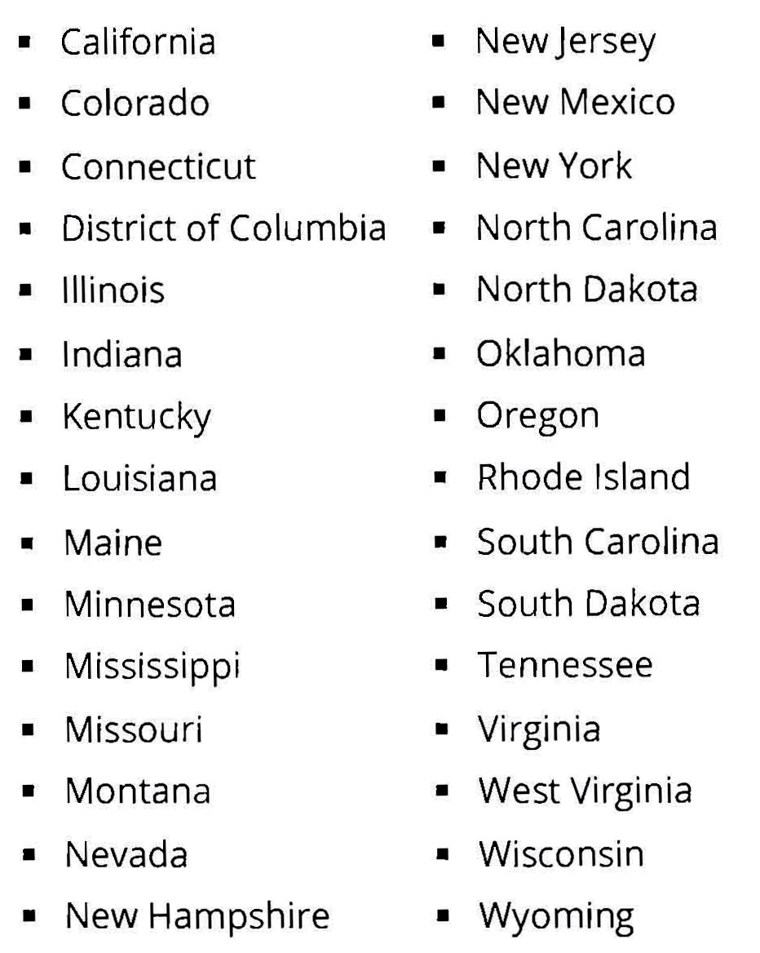
List of states that provide employment protections to smokers
Notes:
If your company is in one of these states, you can’t refuse to hire people just because they smoke (although you can turn them down for other, legitimate reasons).

Slide 56
Drug Abuse
Federal antidrug initiatives include the following:
  The Drug-Free Workplace Act of 1988, which requires federal contractors and recipients of federal grants to take specific steps to ensure a drug-free work environment.
  Department of Defense (DOD) contract rules, which specify that employers entering into contracts with the DOD must agree to a clause certifying their intention to maintain a drug-free workplace.
  Department of Transportation (DOT) regulations, which require that employees whose jobs include safety- or security-related duties be tested for illegal drug use under DOT rules.

Slide 57
Substance Abuse: Supervisor Training
If an employee appears to be under the influence of drugs or alcohol:
  Ask how the employee feels and look for signs of impairment such as slurred speech.
  Do not allow an employee judged unfit to continue working. Send employee for medical care or home.
  Make a written record of your observations and follow up each incident.
  Inform workers of the number of warnings the company will tolerate before requiring termination.
  Refer troubled employees to the company’s employee assistance program.
Notes:
Alcoholism and substance abuse are widespread problems at work. About two-thirds of people with an alcohol disorder work full-time. The effects of alcoholism on the worker and work are severe. Both the quality and quantity of the work decline in the face of a sort of on-the-job absenteeism.
Training supervisors to identify alcoholics or drug abusers and the problems they create is advisable. However, supervisors are in a tricky position: They should be the company’s first line of defense in combating workplace drug abuse, but should avoid becoming detectives or medical diagnosticians.

Slide 58
Observable Behavior Patterns Indicating Possible
Alcohol-Related Problems
Alcoholism Stage | Some Possible Signs of Alcoholism Problems | Some Possible Alcoholism Performance Issues
Early | Arrives at work late Untrue statements Leaves work early | Reduced job efficiency Misses deadlines
Middle | Frequent absences, especially on Mondays Colleagues mentioning erratic behavior Mood swings Anxiety Late returning from lunch Frequent multi-day absences | Accidents Warnings from boss Noticeably reduced performance
Advanced | Personal neglect Unsteady gait Violent outbursts Blackouts and frequent forgetfulness Possible drinking on job | Frequent falls, accidents Strong disciplinary actions Basically incompetent performance
Notes:
This table presents a chart showing observable behavior patterns that indicate alcohol-related problems. As you can see, alcohol-related problems range from tardiness in the earliest stages of alcohol abuse to prolonged, unpredictable absences in its later stages.

Slide 59
Legal Aspects of Workplace Substance Abuse
Employer compliance with the Drug-Free Workplace Act requires:
  Publication of a policy prohibiting the unlawful manufacture, distribution, dispensing, possession, or use of controlled substances in the workplace.
  Establishment of a drug-free awareness program that informs employees about the dangers of workplace drug abuse.
  Informing employees that they are required, as a condition of employment, not only to abide by the employer’s policy but also to report any criminal convictions for drug-related activities in the workplace.
Notes:
The federal Drug-Free Workplace Act requires employers with federal government contracts or grants to ensure a drug-free workplace by taking a number of steps.

Slide 60
Dealing with Substance Abuse
Disciplining
Referral to an outside agency
When an Employee Tests Positive
Discharge
In-house
counseling
Notes:
Disciplining, discharge, in-house counseling, and referral to an outside agency are the four traditional prescriptions for addressing employee substance abuse problems. Most professionals seem to counsel treatment rather than outright dismissal, at least initially. They also emphasize that whether it’s the supervisor or just a friend who notices the employee’s problem, the worst thing to do is ignore it. In practice, each employer tends to develop its own approach to dealing with substance abuse.

Slide 61
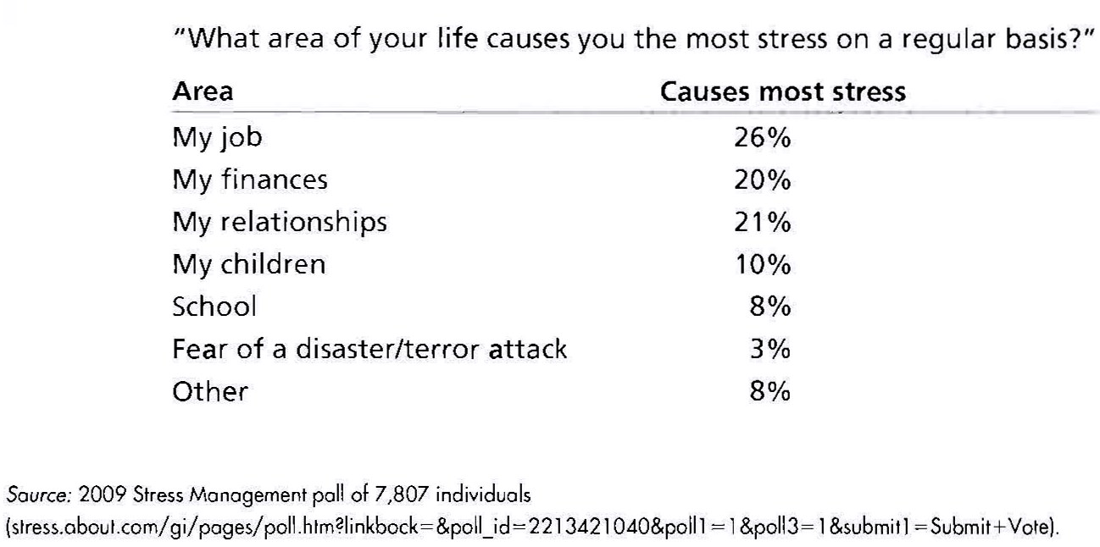
Work Is the Biggest Source of Stress for Most

Slide 62
Several Job Factors Determine
Levels of Stress
People experience greater stress the more their jobs require:
Making decisions
Constantly monitoring devices or materials
Repeatedly exchanging information with others
Working in unpleasant physical conditions
Performing unstructured rather than structured tasks

Slide 63
10 most stressful and 10 least stressful jobs of 2013
http://www.smartplanet.com/blog/bulletin/10-most-stressful-and-10-least-stressful-jobs-of-2013/

Slide 64
Stress Factors and Their Consequences
Workplace factors
  Work schedule
  Pace of work
  Job security worries
  Route to and from work
  Workplace noise
  Poor supervision
  The number and nature
  of customers or clients
Personal Factors
  Personality type
  Non-job factors
Human Consequences
  Anxiety
  Depression
  Anger
  Cardiovascular disease
  Headaches
Employer Consequences
  Diminished quantity and quality of performance
  Increased absenteeism and turnover
  Workplace violence
Notes:
A variety of workplace factors can lead to stress. Personal factors also influence stress. Job stress has serious consequences for both employee and employer.

Slide 65
Reducing Job Stress: Personal
Build rewarding, pleasant, cooperative relationships.
Don’t bite off more than you can chew.
Build an effective and supportive relationship with your boss.
Negotiate with your boss for realistic deadlines on projects.
Learn as much as you can about upcoming events and get
as much lead time as you can to prepare for them.
Find time every day for detachment and relaxation.
Take a walk to keep your body refreshed and alert.
Find ways to reduce unnecessary noise.
Reduce trivia in your job; delegate routine work.
Limit interruptions.
Don’t put off dealing with distasteful problems.
Make a “worry list” that includes solutions for each problem.
Get more and better quality sleep.
Practice meditation when stressed.
Notes:
There are a number of ways to alleviate dysfunctional stress. These range from commonsense remedies (such as getting more sleep and eating better) to remedies like biofeedback and meditation.

Slide 66
Reducing Job Stress: Organizational
Provide supportive supervisors.
Ensure fair treatment for all employees.
Reduce personal conflicts on the job.
Have open communication between management and employees.
Support employees’ efforts, for instance, by regularly asking how they are doing.
Ensure effective job-person fit, since a mistake can trigger stress.
Give employees more control over their jobs.
Provide EAP including professional counseling.
Notes:
The employer and its human resource team and supervisors also play a role in reducing stress. Supportive supervisors and fair treatment are two obvious steps. Other steps include reducing personal conflicts on the job and encouraging open communication between management and employees.

Slide 67
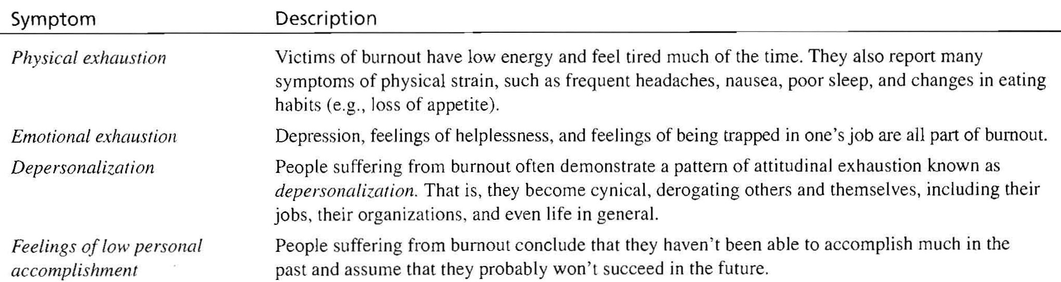
Burnout: The total depletion of physical and mental resources caused by excessive striving to reach an unrealistic work-related goal
Notes:
Bakker, A. B. et al. (2000). Patient demands, lack of reciprocity, and burnout: A five-year longitudinal study among general practitioners. Journal of Organizational Behavior, 21, 425-441.
Depersonalization: It consists of a feeling of watching oneself act, while having no control over a situation. Subjects feel they have changed, and the world has become vague, dreamlike, less real, or lacking in significance. It can be a disturbing experience, since many feel that, indeed, they are living in a "dream". It’s like seeing oneself in the third person.

Slide 68
Recovering from Burnout
  Break the usual patterns to achieve a more well-rounded life.
  Get away from it all periodically to think alone.
  Reassess goals in terms of their intrinsic worth and attainability.
  Think about work: could the job be done without being so intense?
Notes:
Burnout is a phenomenon closely associated with job stress. Burnout builds gradually, manifesting itself in symptoms such as irritability, discouragement, exhaustion, cynicism, entrapment, and resentment. This slide lists ways that an individual can recover from burnout.

Slide 69
Employee Depression
Warning signs of depression
(if they last for more than 2 weeks) include:
  Persistent sad, anxious, or “empty” moods
  Sleeping too little
  Reduced appetite
  Loss of interest in activities once enjoyed
  Restlessness or irritability
  Difficulty concentrating
Notes:
Employee depression is a serious problem at work. Employers need to work harder to ensure that depressed employees actually utilize available support services.
Depression is a disease. Employers therefore need to train supervisors to identify depression’s warning signs and to counsel those who may need such services to use the firm’s employee assistance program.

Slide 70
Other Safety and Health Issues
Computer-Related Ergonomic Problems
  Avoiding cumulative motion disorders
    Employees should take a 3–5 minute break from working at the computer every 20–40 minutes, and use the time for other tasks.
    Design maximum flexibility and adaptability into the workstation. Don’t stay in one position for long periods.
    Reduce glare with devices such as shades over windows and recessed or indirect lighting.
    Give workers a complete preplacement vision exam to ensure properly corrected vision for reduced visual strain.
    Allow for positioning wrists at the same level as the elbow.
    Put the screen at or just below eye level, at a distance of 18
    to 30 inches from the eyes.
    Let the wrists rest lightly on a pad for support.
    Put the feet flat on the floor or on a footrest.
Notes:
NIOSH provides these general recommendations regarding computer work stations. Most relate to ergonomics or design of the worker–equipment interface.

Slide 71
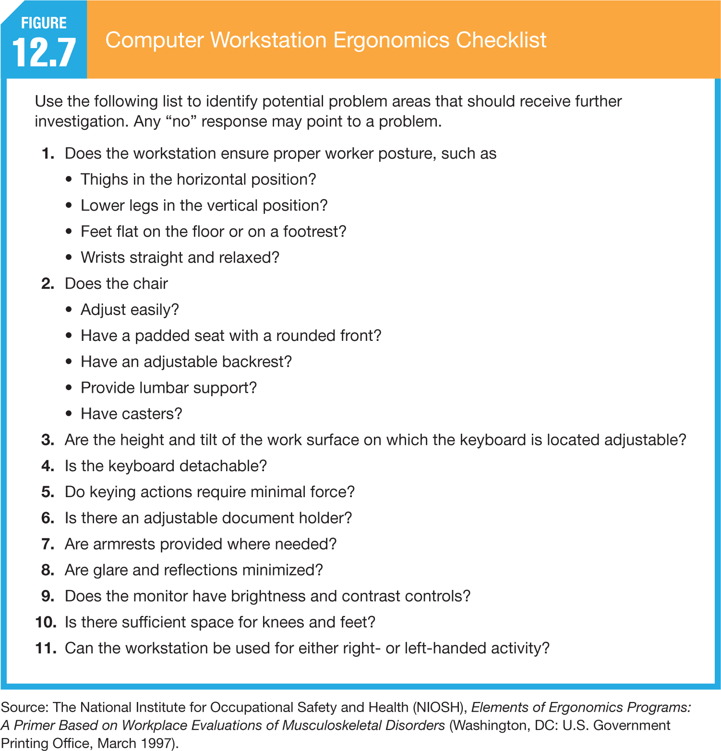

Slide 72

Promoting a Safe Work Environment
Creating a Culture of Safety
  Interviewing for Safety and Fitness-for-Duty Tests
  The Key Role of the Supervisor
  Proactive Safety Training Programs
Notes:
Generally speaking, a fitness-for-duty test/exam is a medical examination of a current employee to determine whether the employee is physically or psychologically able to perform the job. Sometimes, fitness-for-duty exams are required when an employee is ready to return to work after taking time off for a serious illness or injury. For example, an employee with a serious back injury might have to take a fitness-for-duty exam before coming back to work, to make sure the employee is capable of meeting the physical requirements of the job. A fitness-for-duty exam might also be required of an employee whose conduct on the job gives the employer reason to believe that the employee is not able to perform the job safely. For example, if a forklift operator is found unconscious at the controls, the employer could require the employee to get checked out, to make sure the employee doesn't pose a serious safety risk.
If the employee has a disability, the rules are stricter. Fitness-for-duty exams may reveal information about an employee's disability, so they are regulated by the ADA. If an employee has a disability, an employer may require a fitness-for-duty exam only if the exam is job-related and consistent with business necessity. This standard will generally be met if the employer has a reasonable belief that:
the employee's condition may prevent the employee from performing the job's essential functions, or
the employee poses a direct threat to his or her own safety or the safety of others.
The employer's belief has to be based on facts, not on stereotypes or assumptions about the employee's condition.

Slide 73
Creating a Culture of Safety
Promoting Safety Awareness
  The Key Role of the Supervisor
    Communicating the need to work safely.
  Proactive Safety Training Program
    First aid, defensive driving, accident prevention
    techniques, hazardous materials, and emergency procedures.
  Information Technology and Safety Awareness
  and Training
    Enhanced delivery modes
    Customization of training needs
    Regulatory instruction
      OSHA’s Web-based eTools

Slide 74
Creating a Culture of Safety (cont.)
Typical Safety Rules
  Using proper safety devices
  Using proper work procedures
  Following good housekeeping practices
  Complying with accident- and injury-reporting procedures
  Wearing required safety clothing and equipment
  Avoiding carelessness and horseplay

Slide 75
Enforcing Safety Rules
Ways to involve and engage employees in company safety programs…..
  Jointly set safety standards with managers,
  Participate in safety training,
  Help design and implement special safety training programs,
  Establish safety incentives and rewards, and
  Be involved in accident investigations.

